Slide 1
WELCOME
Achieving ACHC Home Health Accreditation
Presenter:
Becky Tolson, RN, BS
Clinical Compliance Educator

Slide 2
Also Joining Our Training Today
Greg Stowell - Associate Director, Education & Training
Lindsey Holder – Senior Manager, Education & Training
Suzie Steger - Senior Education & Training Coordinator
Steve Clark – Education Services Specialist

Slide 3
Optimize Your Workshop Experience
During our presentation
  Use the Questions feature in the GoToWebinar navigation pane to ask your questions throughout the presentation
During the live Q&A
  Type in the Questions box you would like to ask a question (or use the raise your hand feature)
  Our team will recognize you and unmute your mic
  Help us to make the information personal to your business!
Since this is a live event, connection issues can happen
  If on your end, just use the same GoToMeeting link and reconnect
  If on our end, look for instructions in your email on how we can reconnect

Slide 4
Nursing Contact Hours
Nursing contact hours for this workshop are provided by the Virginia Nurses Association.
The number of hours earned will depend on registration and attendance
(7 hours per day and 1 hour for the recorded session).
You must attend the full day to be eligible and attest that you have watched the pre-recorded session.
Only registered attendees are eligible for contact hours.
If you are not registered and would like to receive contact hours, please contact us.
Contact hour assistance or questions:
  Suzie Steger - ssteger@achcu.com
  Steve Clark - sclark@achcu.com

Slide 5
Items Needed For Virtual Training
You should have received an email with a link to the following information:
  ACHC Standards
  ACHC Accreditation Process
  The presentation for today
  The ACHC Accreditation Guide to Success
If you have not received the email or are unable to download the information, contact customerservice@ACHCU.com for assistance.

Slide 6
Objectives
Review the ACHC Accreditation Process.
Learn how to prepare an organization for the ACHC Accreditation Survey.
Establish expectations for on-site survey and strategies for survey success.
Learn how to utilize the ACHC Accreditation Guide to Success to ensure ongoing compliance.
Identify how to avoid condition-level deficiencies.
Review the ACHC Accreditation Standards to understand expectations
for compliance.

Slide 7
Home Health Accreditation
ACHC earned CMS Deeming Authority in 2006.
Accredits more than 2,600 locations nationally.
Program-specific standards include Conditions of Participation (CoPs).
Agencies have the ability to choose from a comprehensive group of services, including:
  Skilled Nursing
  Home Health Aide
  Physical Therapy
  Occupational Therapy
  Speech Therapy
  Social Work
  Palliative Care
  Behavioral Health Home Care
  Telehealth

Slide 8
ACHC Accredited Agencies

Slide 9
Distinction in Palliative Care
Distinction in Palliative Care:
  Home Health
Additional one day on survey:
  Must have provided care to three patients, with two active at time of survey.
  <150 palliative care patients: three total record reviews with one home visit.
  150 or more palliative care patients: four total record reviews with two
  home visits.
ACHC standards were based on the National Consensus Project for Quality Palliative Care guidelines.

Slide 10
Distinction in Behavioral Health
Distinction in Behavioral Health:
  Home Health
Additional one day on survey:
  Must have provided care to three patients, with two active at time of survey.
  <150 Behavioral Health patients: three total record reviews with one home visit.
  150 or more Behavioral Health care patients: four total record reviews with two home visits.

Slide 11
Distinction in Telehealth
Distinction in Telehealth
  Telehealth may include remote client/patient monitoring (RPM), biometrics, video, talk, or education.
Additional one day on survey
  Three additional records will be reviewed.
  One virtual patient contacted.
  Personnel charts reviewed for competencies and to ensure a telehealth manager and alternate are assigned.
ACHC Telehealth standards are based on the American Telemedicine Association’s Home Telehealth Clinical Guidelines.

Slide 12
Better Together: HFAP is Now ACHC
HFAP was founded in 1945 as the nation’s first accrediting organization to validate healthcare quality. In 2020, the program became part of the ACHC family, bringing providers solutions that address the continuum of care.

Slide 13
Poll Question
Notes:
2 questions

Slide 14
Home Health Requirements

Slide 15
Home Health Agency Requirements
General Requirements
  State Operations Manual, Chapter 2, Section 2180C
Is primarily engaged in providing Skilled Nursing services and other
therapeutic services
  Medicare Benefit Policy Manual Chapter 7, Section 40
Policies are established by a group of professionals (associated with the agency), including one or more physicians and one or more Registered Nurses to govern the services that it provides

Slide 16
Home Health Agency Requirements
Provides supervision of above-mentioned services by a physician or RN
Maintains clinical records on all patients
Is licensed pursuant to state or local law
Has in effect an overall plan and budget
Meets the Medicare CoPs
Meets additional requirements as the Secretary finds necessary

Slide 17
Initial Certification Requirements
Approved 855A letter
  Medicare Enrollment Application
  Required for all home health agencies requesting participation in the Medicare program
  www.CMS.gov/MedicareProviderSupEnroll

Slide 18
Initial Certification Requirements
Required number of patients prior to survey
  Served 10 patients requiring skilled care and 7 active at time of survey (at least one patient has had two of services)
  Unless in a medically underserved area, 5-2 (as determined by the Regional Office)
Required services
  Nursing and one other therapeutic services (Aide, Physical Therapy [PT], Occupational Therapy [OT], Speech Therapy [ST], and Social Work [SW] for
  home health)
  Both therapeutic services have to have been provided/are being provided
  At least one service, in its entirety, must be provided directly by a W-2 employee
Fully operational
    State Operations Manual, Chapter 2, section 2008A

Slide 19
Medicare Skilled Services
Catheter care:
  Insertion of catheter
  Irrigation of catheter
  Replacement of catheter
Wound care
  Complex wound dressing
Teaching of a skill
  Self-administration of injectable medications
  Wound care
  Transfer
  Administration of oral medication, side effects, and interactions

Slide 20
Reasonable & Necessary
Must be an identified medical need that the care requires the skills and knowledge of home care staff to safely and properly complete.
If the care can be safely and effectively performed, or self-administered, by an unskilled person, without the direct supervision of a nurse or therapist, the service although a nurse or therapist, the service cannot be regarded as a skilled service although a nurse or therapist provides the services.
The unavailability of a competent person to provide a non-skilled service, regardless of the importance of the service to the patient, does not make it skilled service when a nurse or therapist provides the service.

Slide 21
Homebound Status
For initial Medicare certification surveys, patients do not have to meet the homebound definition.
Once the agency can bill, patients have to meet the definition of homebound status in order to bill.

Slide 22
Intermittent Care
Home Health Medicare benefit requires the care to be intermittent care:
  Care is provided or needed on fewer than 7 days a week, or less than 8 hours each day for periods of 21 days or less (exceptional circumstances when the need for additional care is finite and predictable)
  Does not cover shift work even when provided by a skilled individual

Slide 23
Poll Question
Notes:
2 questions

Slide 24
Separate Entities
Medicare-Certified Home Health & Non-Medicare Home Care

Slide 25
Separate Entities
Chapter 2, The Certification Process, Section2183 - Separate Entities (Separate Lines of Business) (Rev 125, Issued: 10-31-14, Effective: 10-31-14, Implementation: 10-31-14)
The Surveyor must be able to identify the corporate and organizational boundaries of the entity seeking certification or recertification.
The Medicare CoPs apply to the HHA as an entire entity and in accordance with §1861(o)(6) of the Act and are applicable to all individuals served by the HHA and not just to Medicare beneficiaries.
Non-Medicare clients:
  Skilled
  Custodial

Slide 26
Separate Entities
The following criteria should be considered in making a decision regarding whether a separate entity exists:
Operation of the home health agency
  Are there separate policies and procedures?
  Are there separate clinical records for patients receiving home health and private duty services?
  Are personnel identified as belonging to one program or the other and are their personnel records separated?
  Are there separate budgets?
  If the state requires a license for home health, is the agency licensed separately for private duty?

Slide 27
Separate Entities
Consumer Awareness
  Review marketing materials for distinction between the programs.
  Written material should clearly identify the home health agency as separate and distinct from other programs, departments, or other entities of the organization.
Staff Awareness
  Staff should be able to identify the difference in services they provide for
  the home health agency and other programs, departments, or entities of
  the organization.
  Staff who divide time between the separate entities must be appropriately trained and meet the qualifications for home health services.

Slide 28
Poll Question
Notes:
1 question

Slide 29
Achieving A Successful Survey Outcome
Pre-Survey Preparation

Slide 30

ACHC Accreditation Guide To Success
Essential Components
  Each ACHC standard contains “Essential Components” that indicate what should be readily identifiable in policies and procedures, personnel records, medical records, etc.
  Each section also contains audit tools, sample policies and procedures, templates, and helpful hints.
Other Tools
  Each section contains a compliance checklist and a self-assessment tool to further guide the preparation process.
Section Index
  Quickly locate important information for successfully completing the ACHC accreditation process.

Slide 31
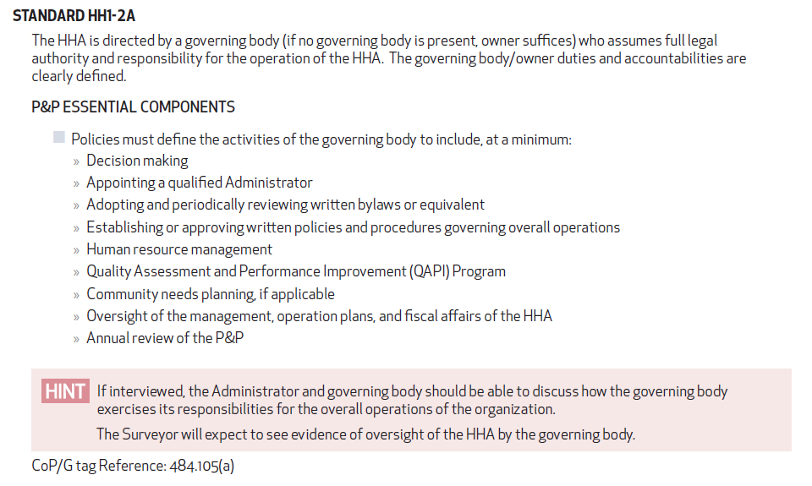

Slide 32
Preparation
Educate Key Staff:
  Clinical staff (employees and contract)
  Administrator, Clinical Director, and alternates
  Governing body
  Patients
Prepare Agency:
  Human resources
  IT/EMR
  Office space:
    Walk around your agency

Slide 33
Preparation
Helpful tools in the ACHC Accreditation Guide to Success
Mock Surveys
  Interview Questions — Survey Process
  Observation of the environment — Survey Process
  Items Needed for the On-Site Visit — Survey Process
  Personnel file audits — Section 4
  Home visits — Section 4
  Medical chart audits — Section 5
  Medicare CoP Checklist — Customer Central

Slide 34
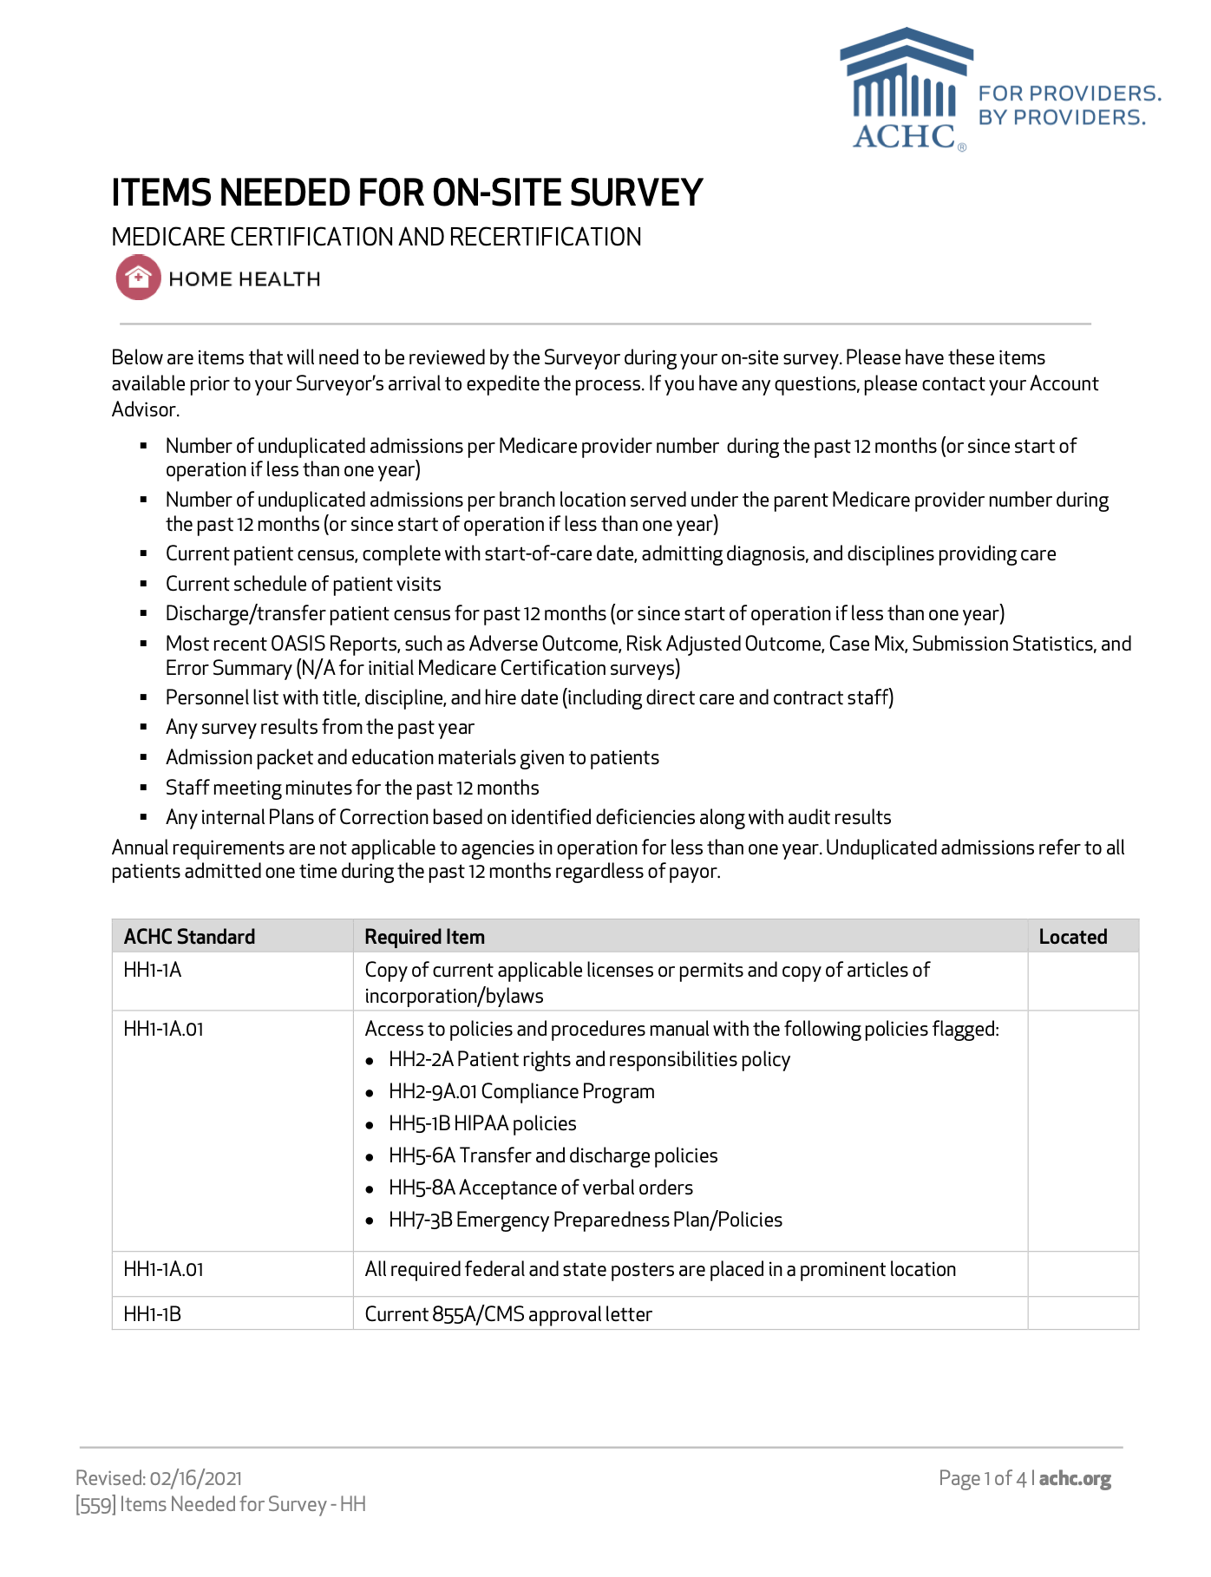
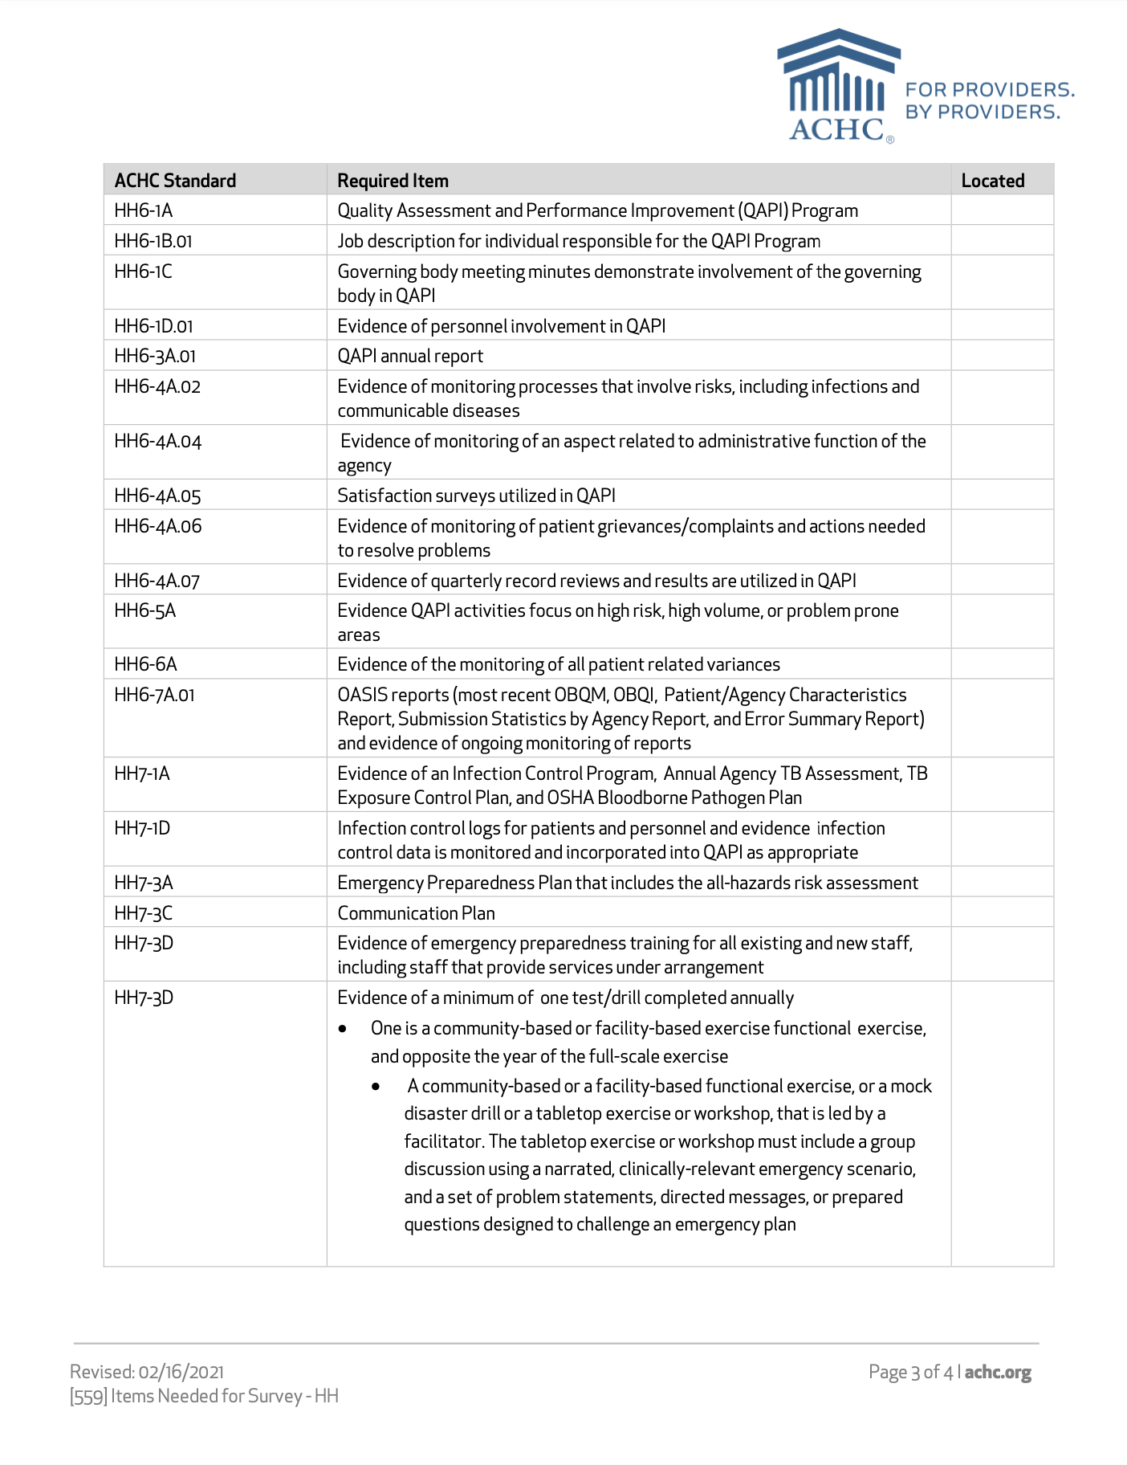
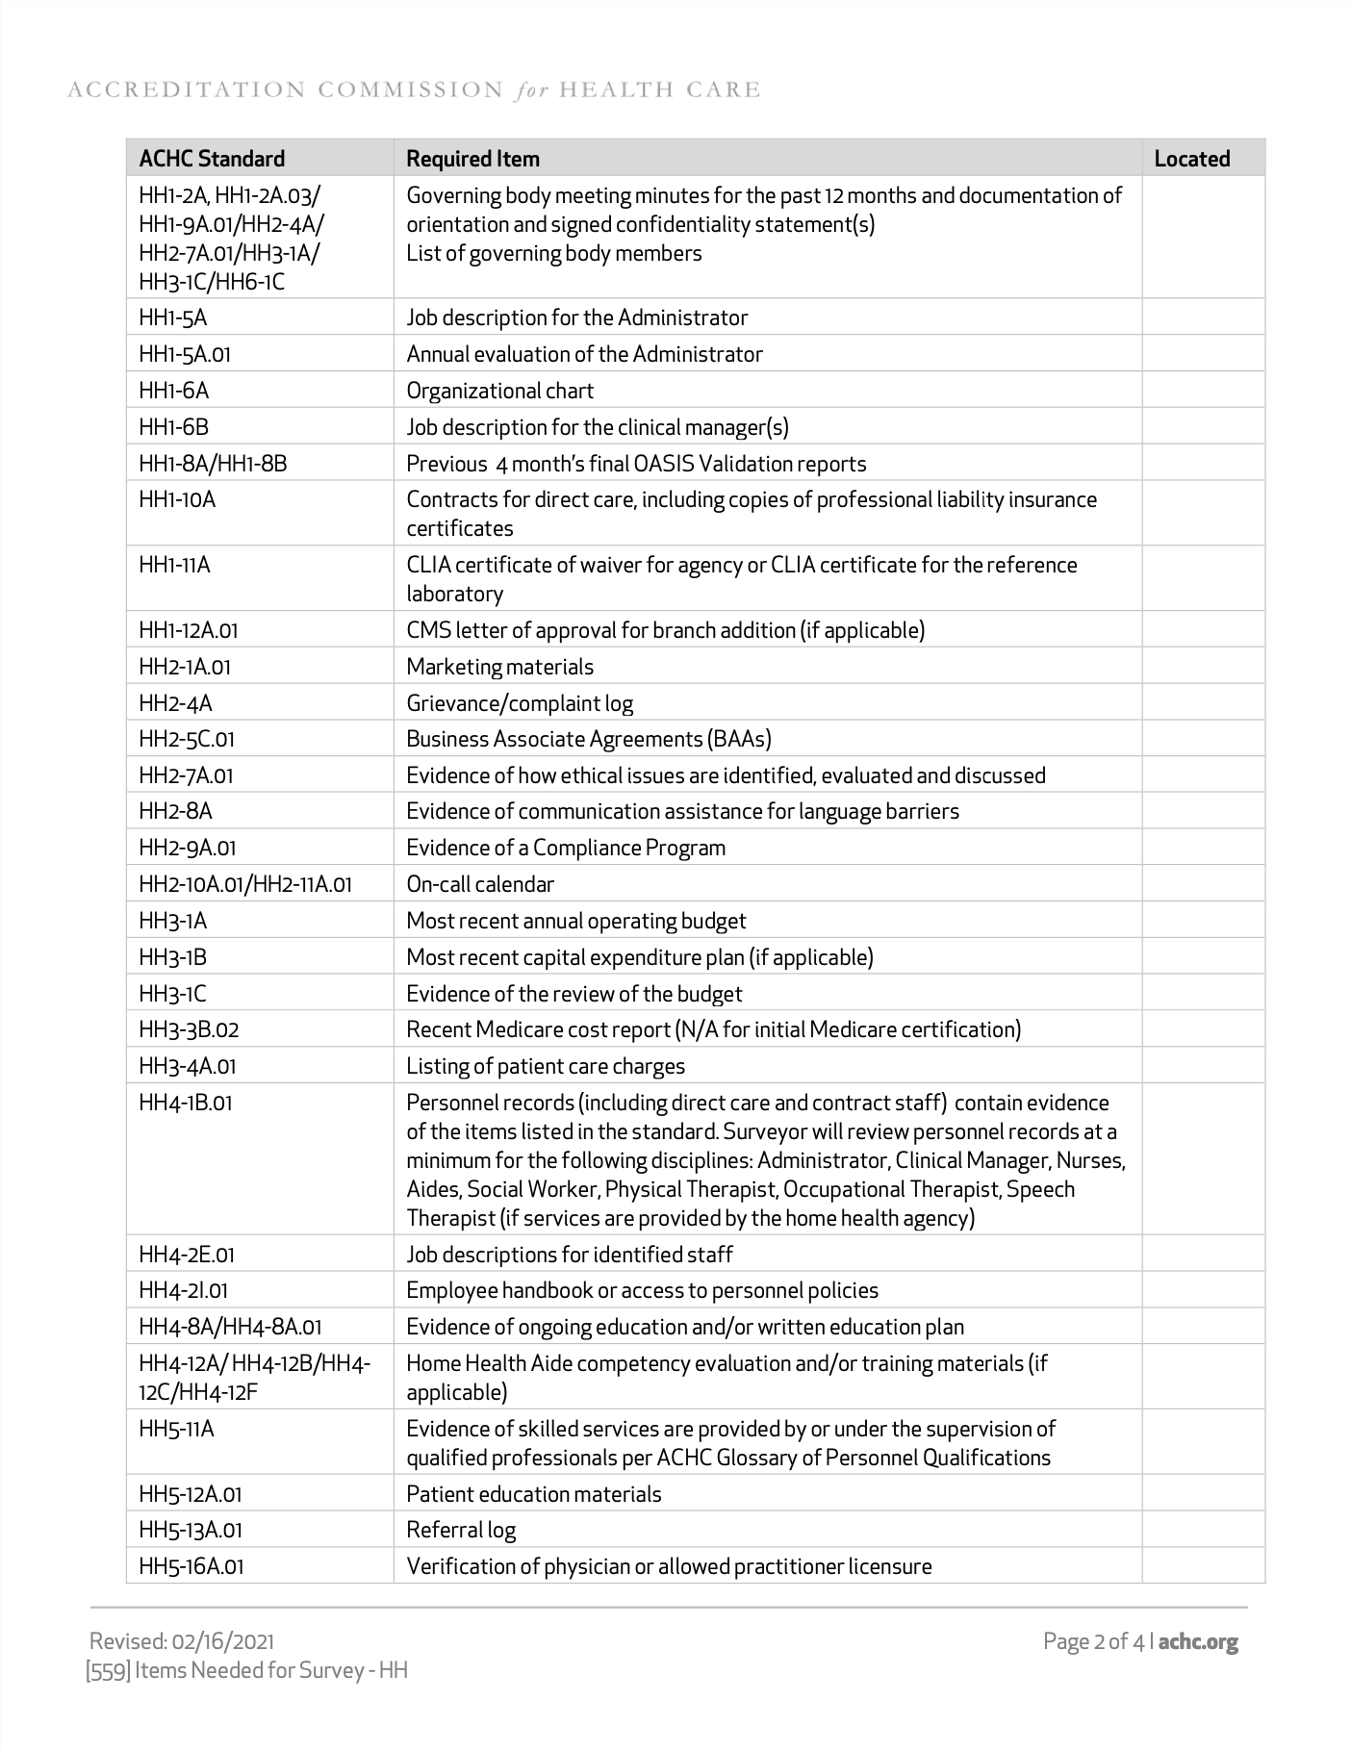
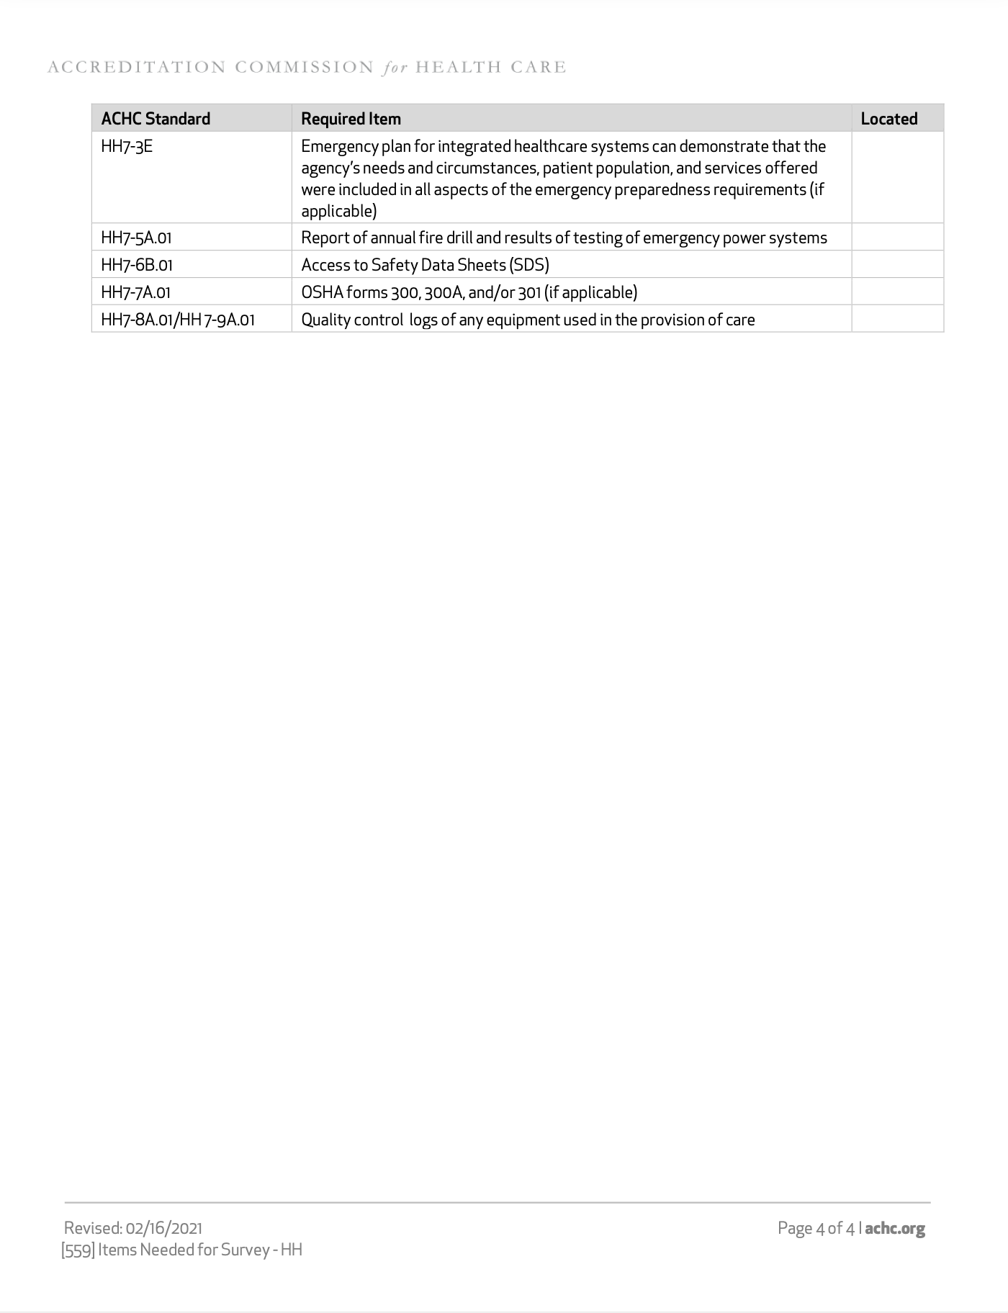
Items Needed For On-Site Survey

Slide 35
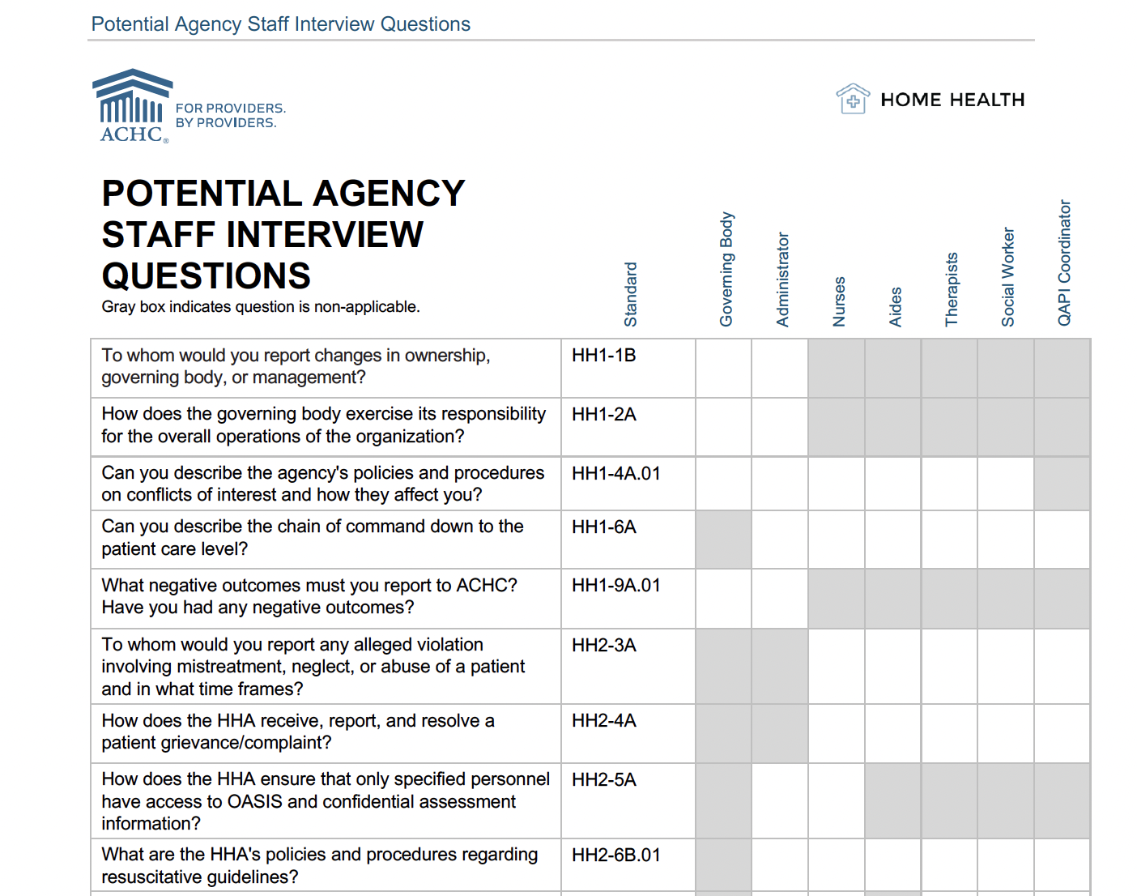
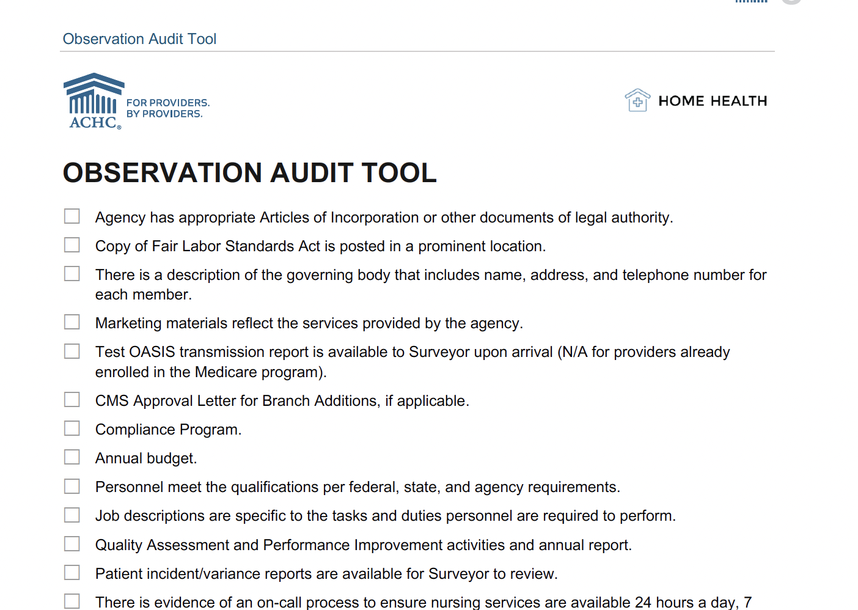
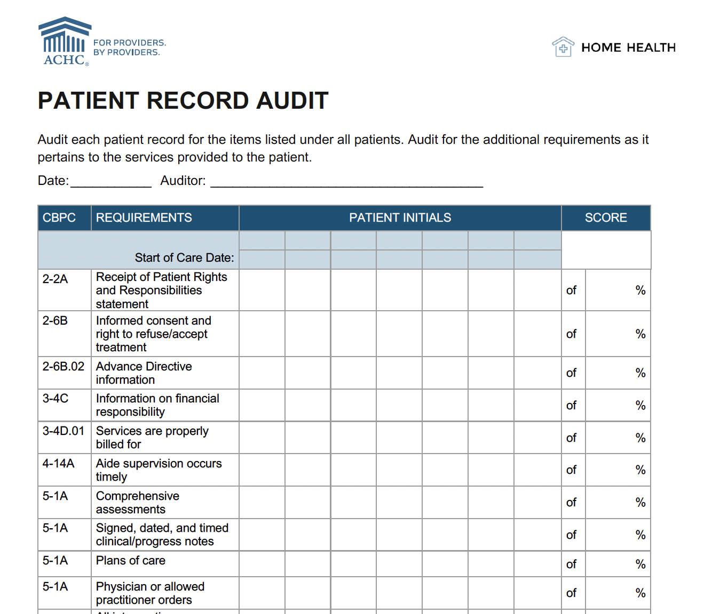
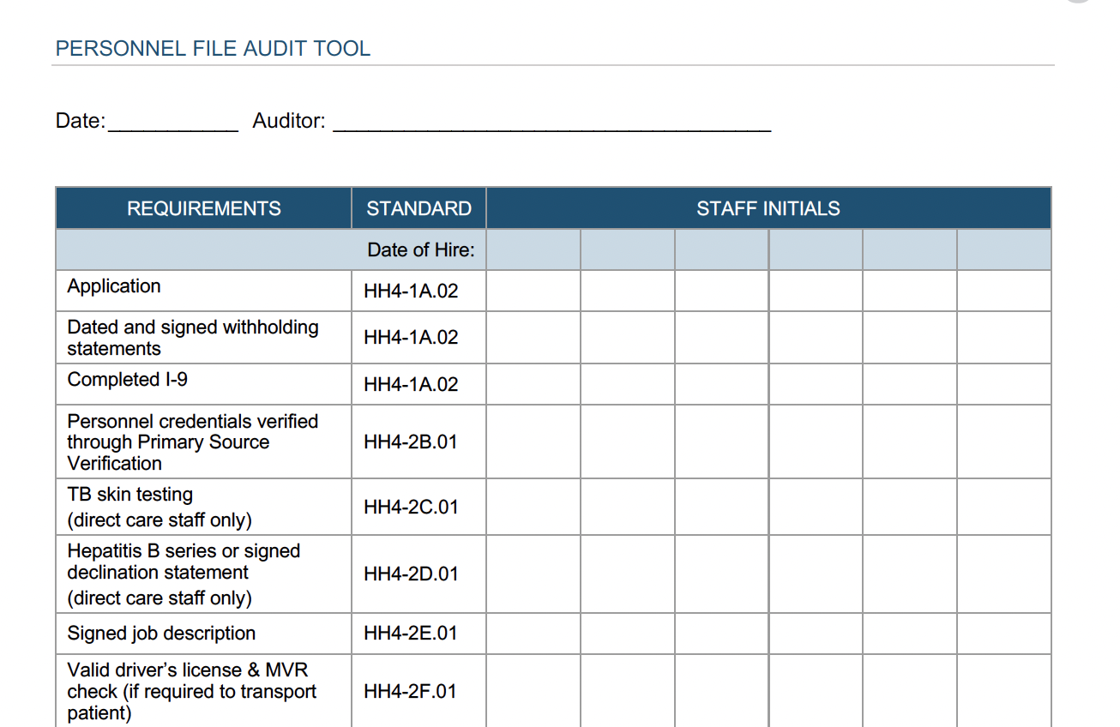
Survey Preparation Tools

Slide 36
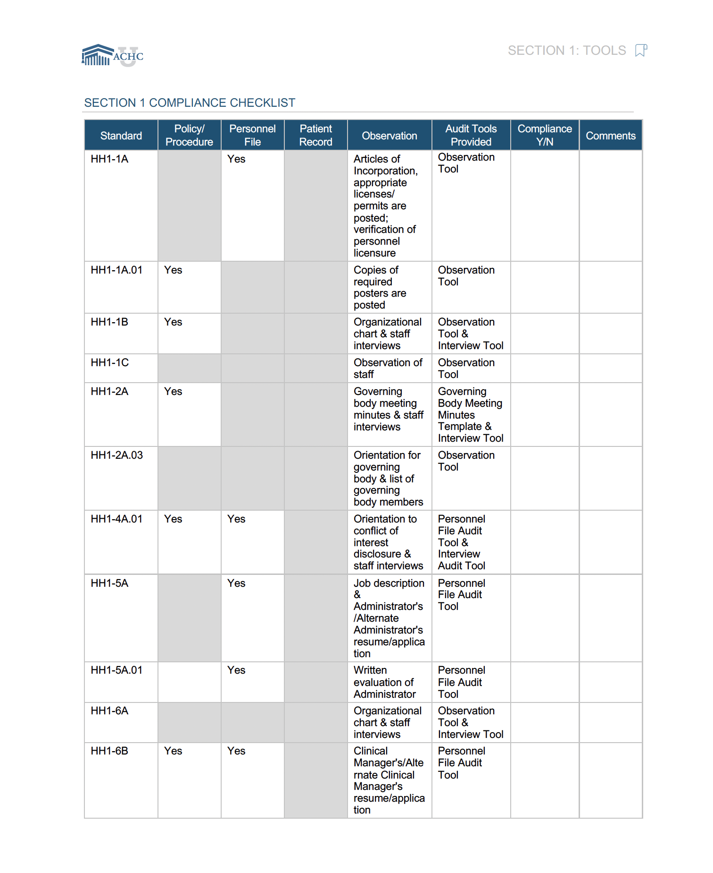
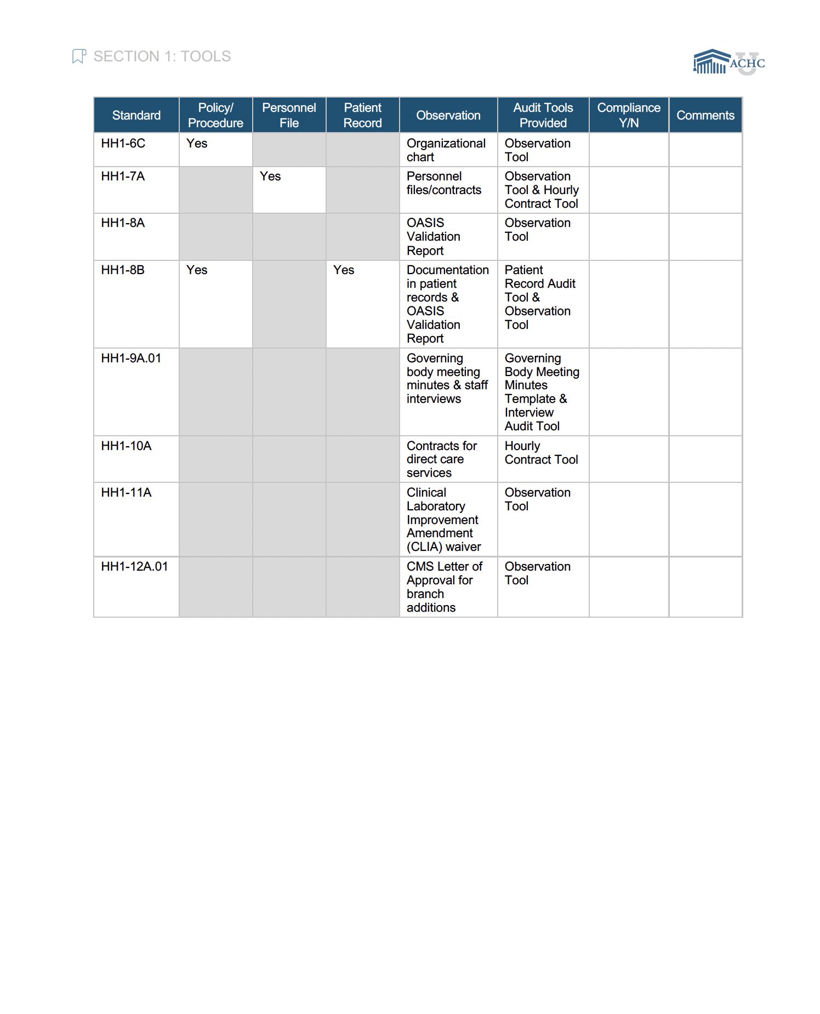
Compliance Checklist

Slide 37
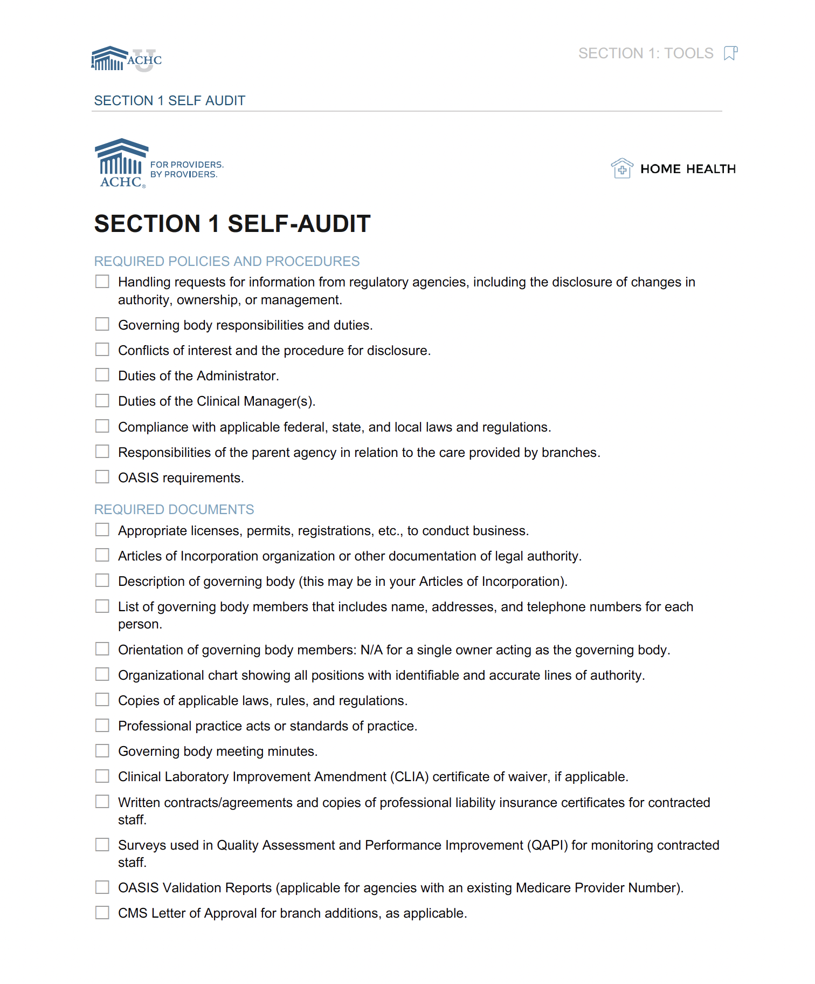
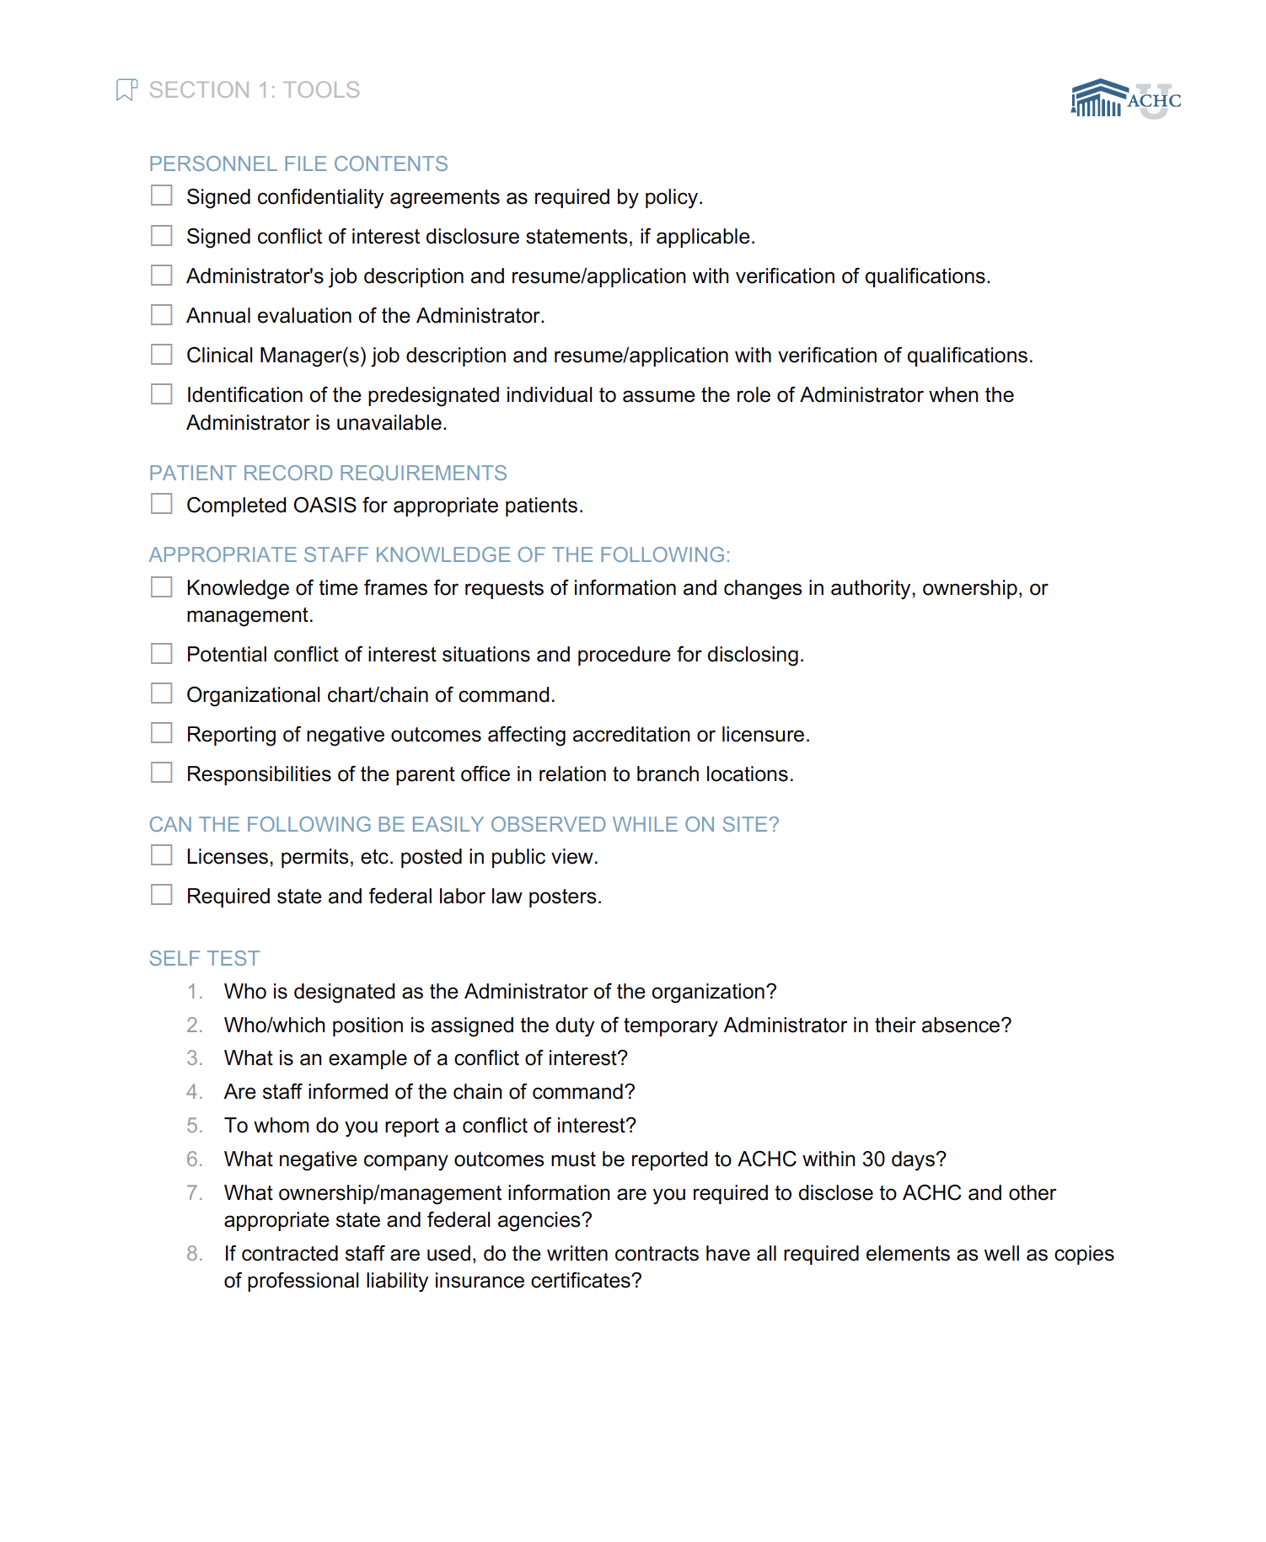
Self-Audit

Slide 38
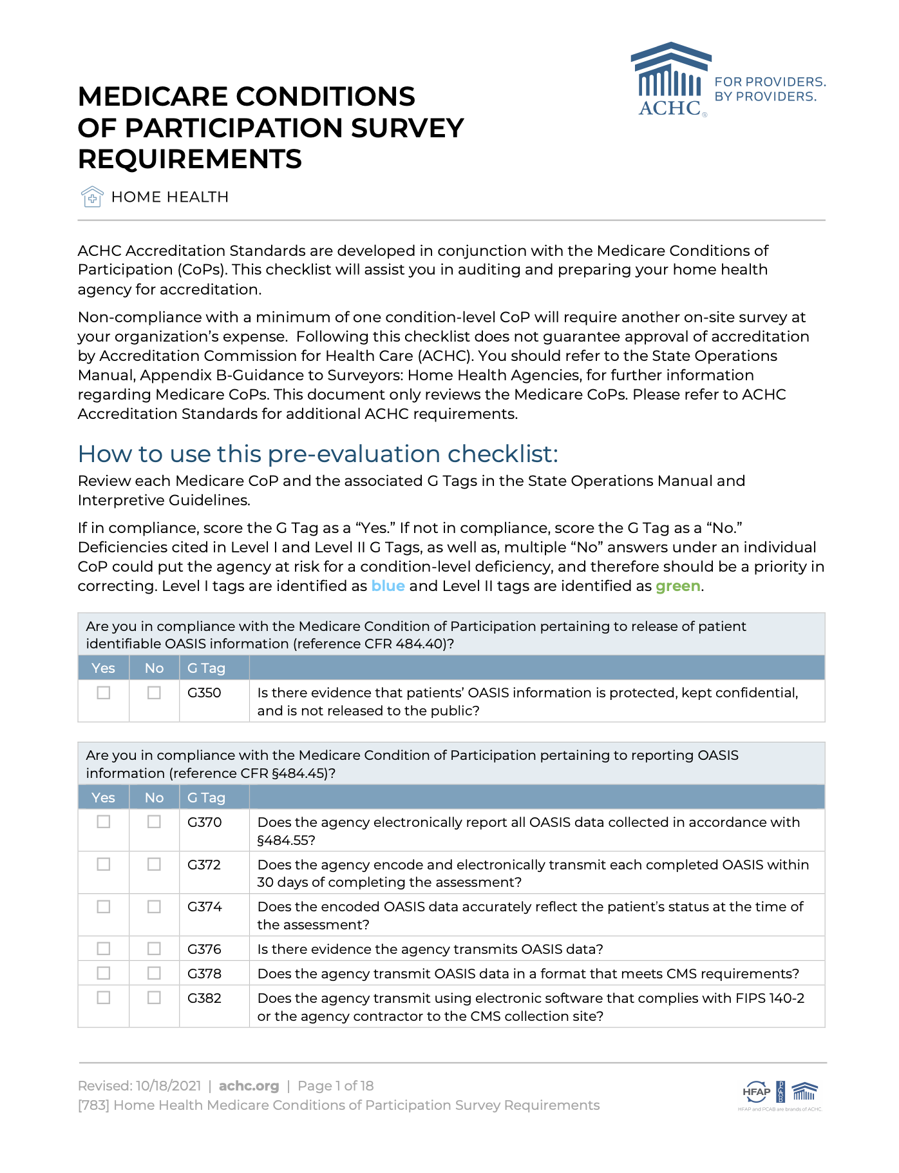
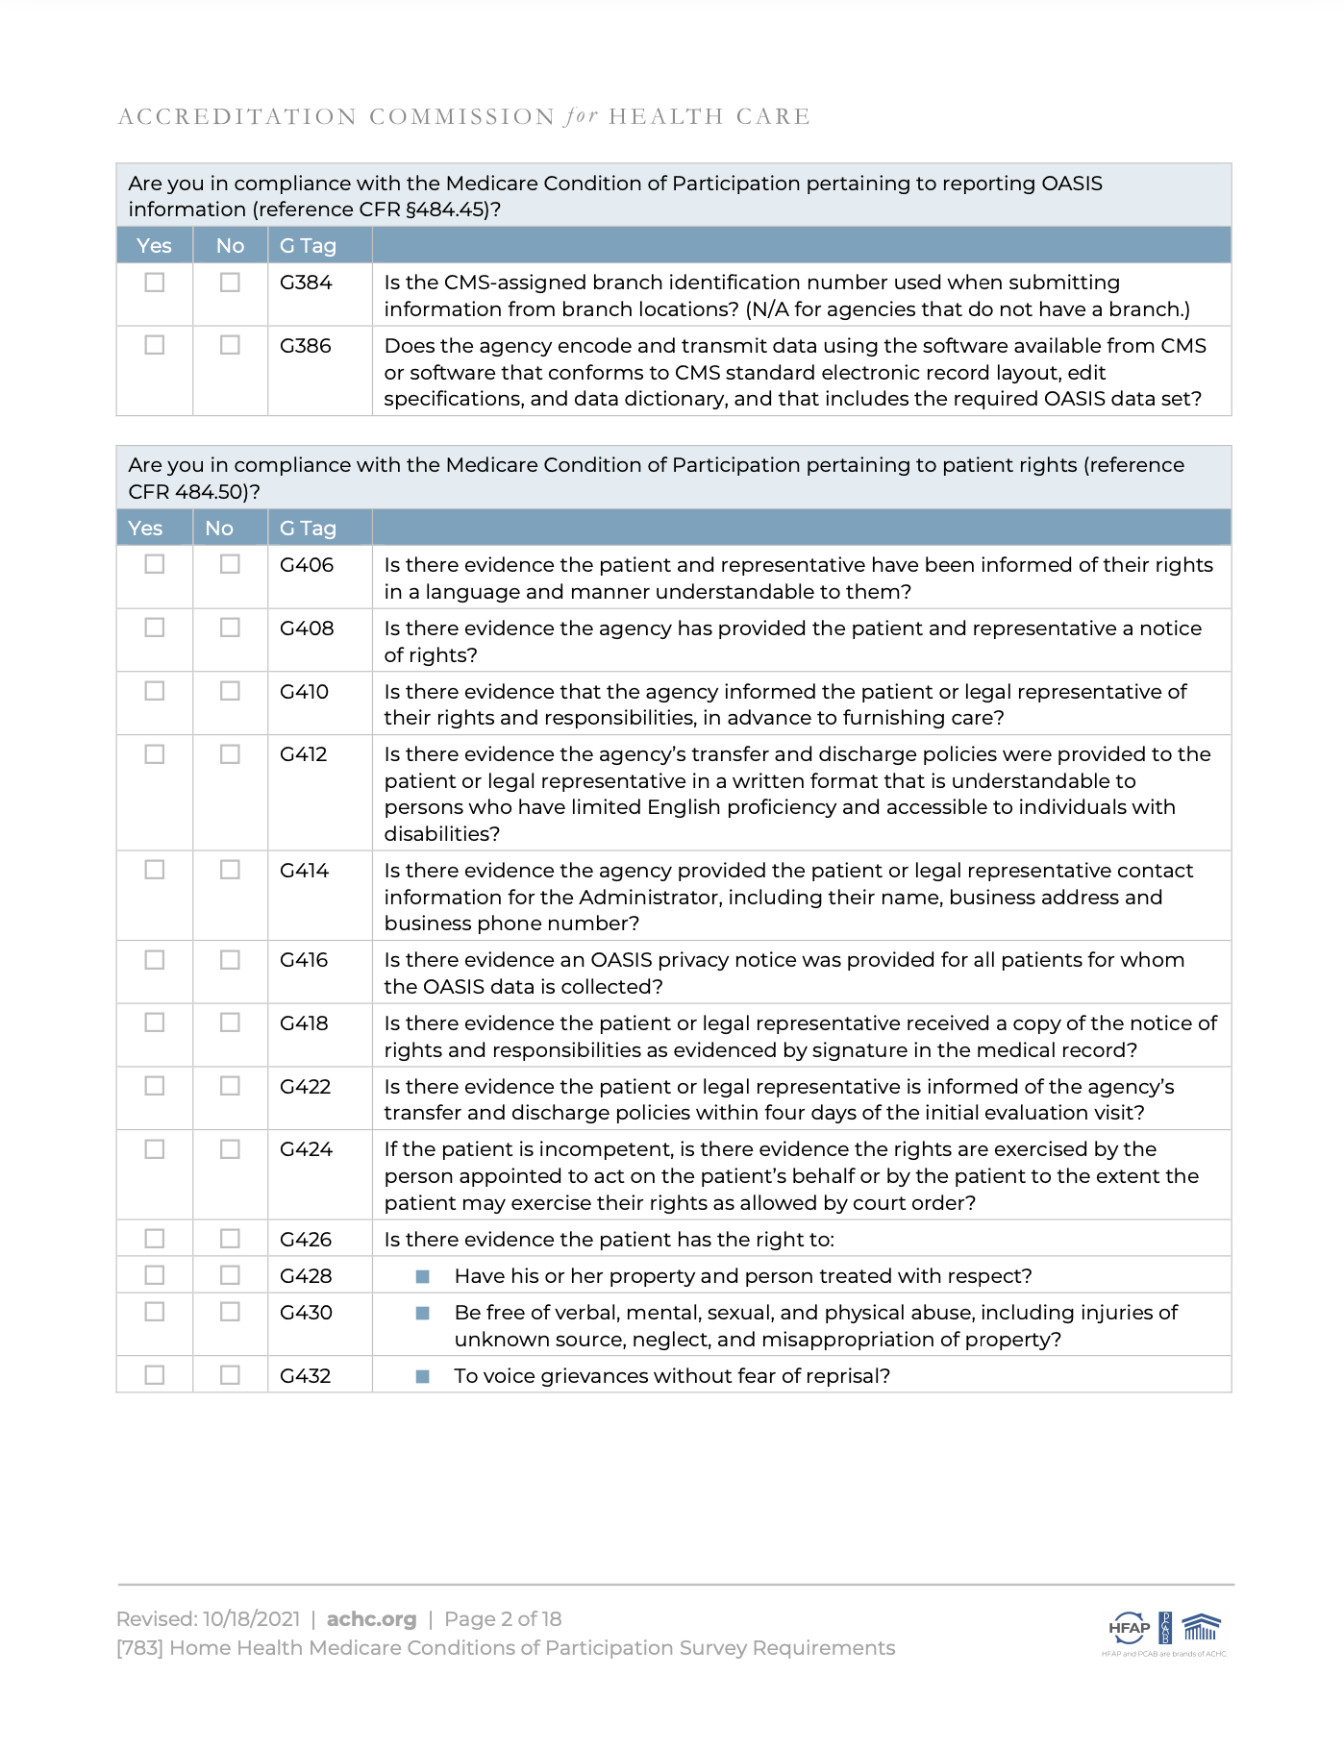
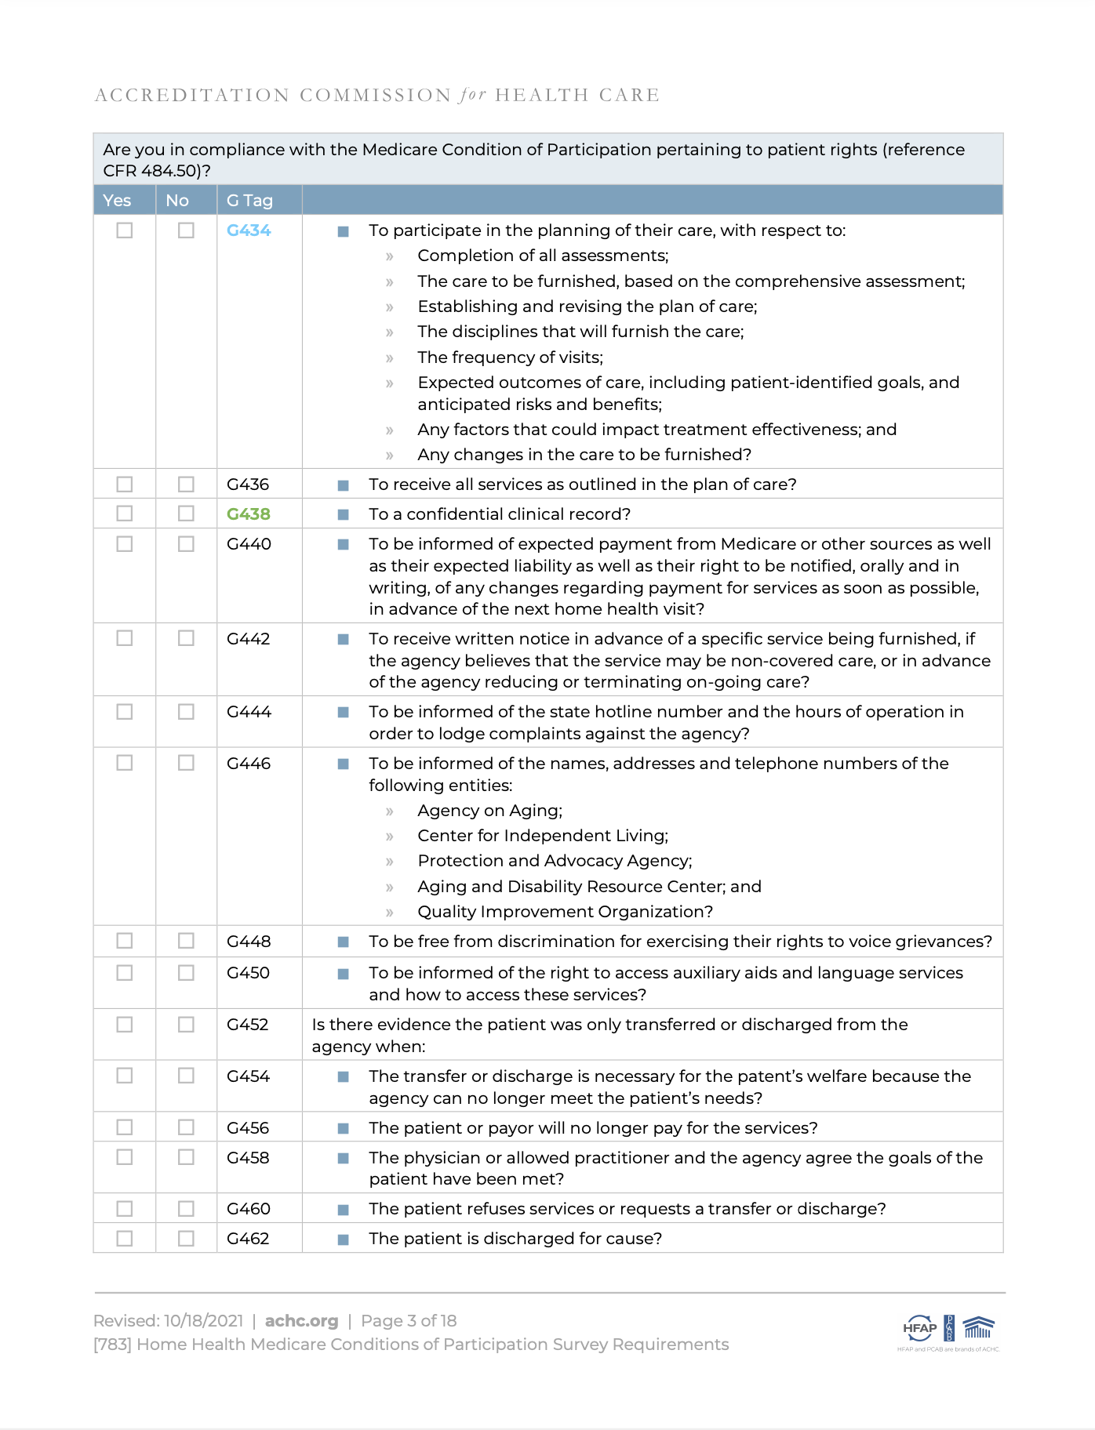
Medicare CoP Checklist

Slide 39
Standard- And Condition-Level Deficiencies
Standard-level deficiencies are ACHC-only deficiencies and individual
G tags:
  Not as “severe”
  Individual, random issue vs. a systemic issue
Condition-level deficiencies result when either an entire condition is out of compliance, multiple G tags under a single condition are out of compliance, or the deficiency is severe:
  Home Health protocols — Level 1 and Level 2 G tags

Slide 40

Focus Areas
Utilize the audit tools, Compliance Checklists, and Self-Assessment to prioritize education.
Implement an internal Plan of Correction (POC).
Share improvements with your Surveyor during survey.

Slide 41

Survey Success
Key to survey success is compliance with the Medicare Conditions of Participation (CoPs)!

Slide 42
Poll Question
Notes:
1 question

Slide 43
Questions?

Slide 44
Achieving A Successful Survey Outcome
On-site Survey Process

Slide 45
On-Site Survey
Notification call
Opening conference
Tour of facility
Personnel file review
Patient home visits/patient chart review
Interview with staff, management, and governing body
Review of agency’s implementation of policies
Quality Assessment Performance Improvement (QAPI)
Emergency Preparedness Plan
Exit conference

Slide 46
Opening Conference
Begins shortly after arrival of Surveyor
Completion of CMS paperwork
Good time to gather information needed by the Surveyor
KEY REPORTS
  Unduplicated admissions:
    Every patient admitted one time in the past 12 months regardless of payor for all locations served by the Medicare provider number.
  Current census and current schedule of visits:
    Name, diagnosis, start-of-care date, disciplines involved
  Discharge and transfers
  OASIS reports
  Personnel and contracted individuals:
    Name, start of hire, and discipline/role

Slide 47
Opening Conference
Any previous survey results from past 12 months
Patient admission packet and education materials
Any internal Plans of Correction developed to correct identified deficiencies
Designate a space for the Surveyor(s)
Laptop or computer to access medical records
  Read-only access
Agency policies and procedures
Appoint a liaison

Slide 48
Tour
Brief tour of facility
  Medical record storage
  Maintaining confidentiality of Protected Health Information (PHI)
  Supply closet
  Biohazard waste
  Required posters
  Fire extinguishers/smoke detectors/non-smoking signage
  Restrooms

Slide 49
Personnel File Review
Review personnel records for key staff and contract staff
  Application, tax forms, and I-9
  Job descriptions and evaluations
  Verification of qualifications
  Orientation records, competencies, ongoing education
  Medical information
  Background checks
For a complete listing of items required in the personnel record, review Section 4
of the ACHC Accreditation Standards.

Slide 50
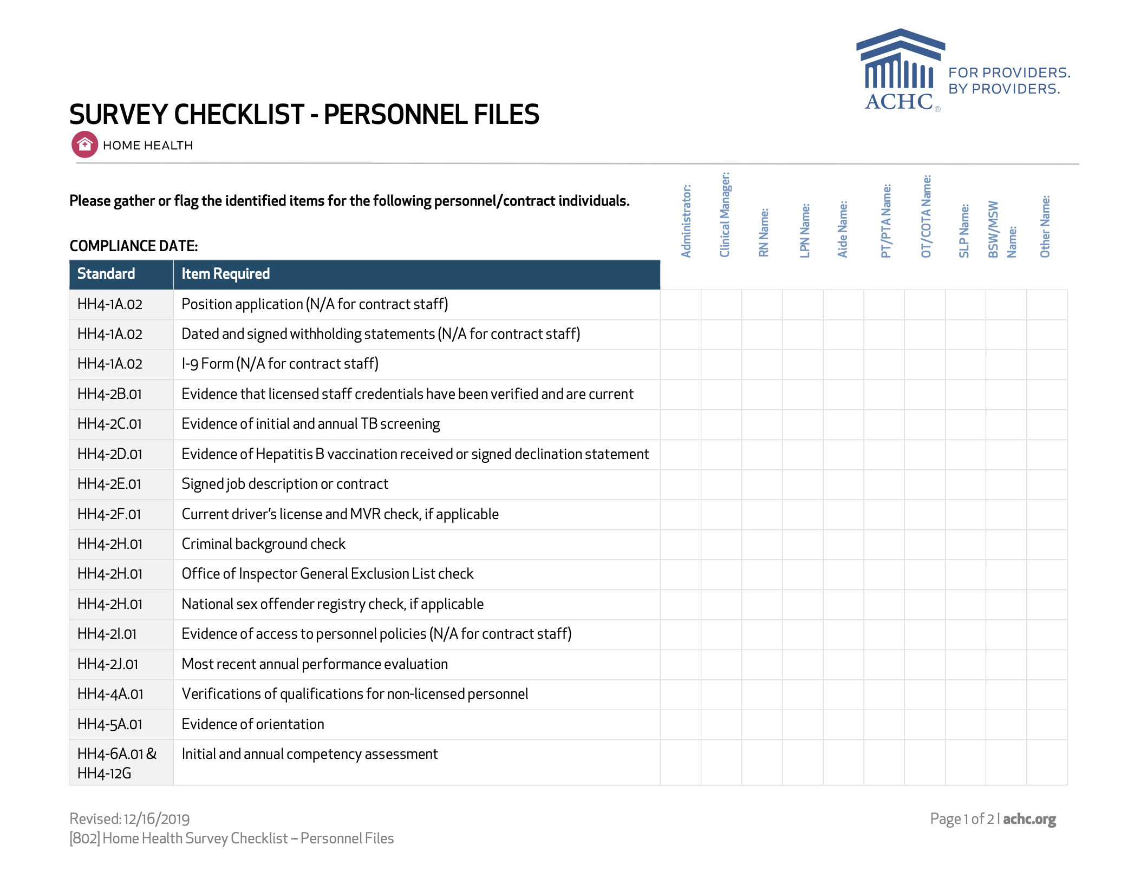
Personnel File
Review

Slide 51
Medical Chart Reviews
CMS requirement based on unduplicated admissions for the last 12 months
Representative of the care provided:
  Pediatric-geriatric
  Environment served
  Medically complex
  All locations
  All payors
Electronic Medical Record :
  Do not print the medical record.
  Surveyor needs access to the entire record — Read-only format.
  Agency needs to provide a laptop/desktop for the Surveyor.
  Navigator/outline.

Slide 52
Home Visits
CMS requirement based on unduplicated admissions for last 12 months
Visits will be with patients already scheduled for visits if census is large enough to accommodate
Agency responsibility to obtain consent from patient/family
Prepare patients and families for potential home visits
Surveyor transportation

Slide 53
Record Review/Home Visits
Unduplicated Admissions | Minimum # of Active Record Reviews Without Home Visits | Minimum # of Record Reviews With Home Visits | Minimum # of Closed Record Reviews | Total Record Reviews
300 or less | 2 | 3 | 2 | 7
301-500 | 3 | 4 | 3 | 10
501-700 | 4 | 5 | 4 | 13
701 or greater | 5 | 7 | 5 | 17

Slide 54
Exit Conference
Mini-exit:
  At end of each day, identify deficiencies; plan for next day.
Final exit conference:
  Present all corrections prior to the Exit Conference.
  Surveyor cannot provide a score.
  Invite those you want to attend.
  Preliminary Summary of Findings (SOF) as identified by Surveyor and the ACHC standard/CoP.
  Seek clarification from your Surveyor while still on site.

Slide 55
Corrected On Site
ACHC only/non-CoP requirements can be corrected on site and a Plan of Correction (POC) will not be required.
G tags that are corrected on site will still be scored as a “No” and a POC will be required.
  Always want to demonstrate regulatory compliance

Slide 56
Poll Question
Notes:
1 question

Slide 57
Questions?

Slide 58
Achieving A Successful Survey Outcome
Post-Survey Process

Slide 59
Post-Survey Process
ACHC Accreditation Review Committee examines all the data.
Accreditation decision is determined based primarily on CoP/G tag deficiencies.
Summary of Findings is sent within 10 business days from the last day of survey.

Slide 60
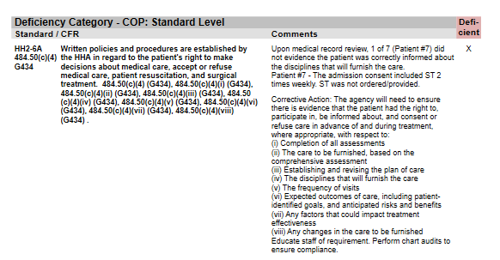
Summary Of Findings Sample

Slide 61
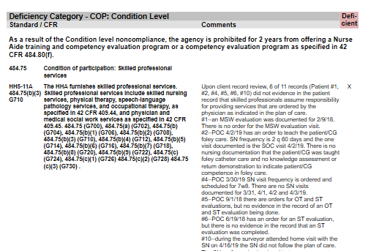
Summary Of Findings Sample

Slide 62
Standard- and Condition-Level Deficiencies
Standard-level deficiencies are ACHC-only deficiencies and individual G tags:
  Not as “severe”
  Individual, random issue vs. a systemic issue
  Only require a Plan of Correction
Condition-level deficiencies result when either an entire condition is out of compliance, multiple G tags under a single condition are out of compliance, or the deficiency is severe.
  Home Health Agency Survey Protocols
    Level 1 and Level 2 G tags
  Requires another on-site survey
    Startups require another full survey

Slide 63
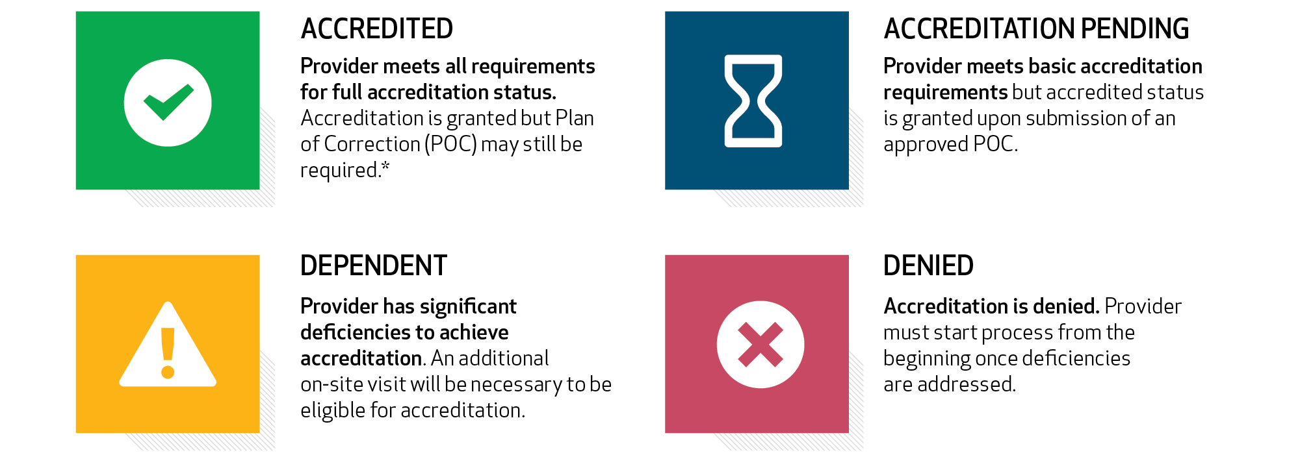
ACHC Accreditation Decisions

Slide 64
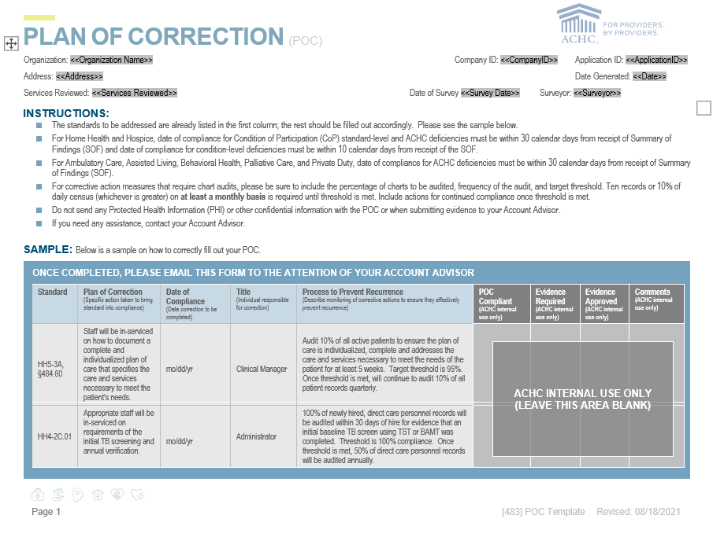

Plan of Correction

Slide 65

Plan of Correction Requirements
Due in 10 calendar days to ACHC
Deficiencies are autofilled
Plan of Correction:
  Specific action step to correct the deficiency
Date of compliance of the action step:
  10 calendar days for condition-level
  30 calendar days for standard-level
Title of individual responsible
Process to prevent recurrence (two-step process):
  Percentage and frequency
  Target threshold
  Maintaining compliance

Slide 66
Evidence
Evidence is required to support compliance.
Once POC is approved, POC identifies which deficiencies will require evidence.
All evidence to the Account Advisor within 60 days.
No PHI or other confidential information of patients or employees.
Accreditation can be terminated if evidence is not submitted.
  Additional evidence may be required based on the decision of the
  ACHC Review Committee.

Slide 67
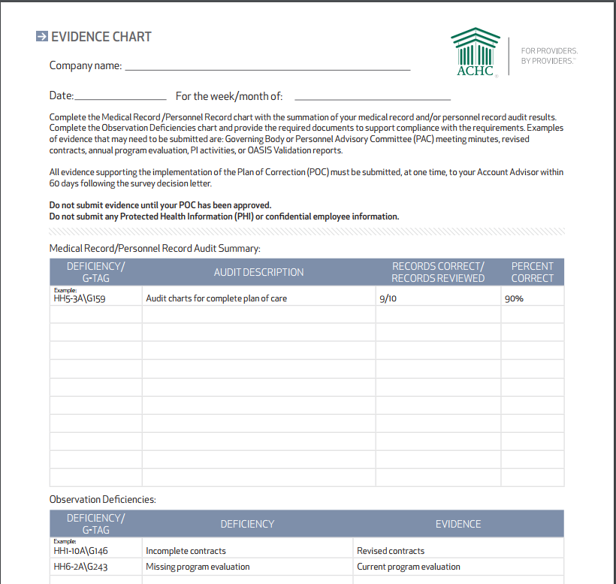

Sample Audit Summary

Slide 68
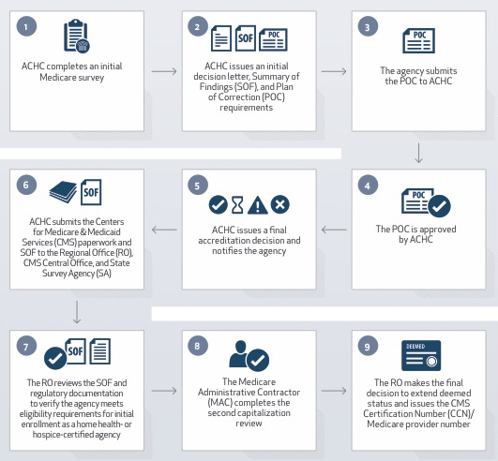
After Accreditation

Slide 69
Poll Question
Notes:
1 question

Slide 70
Questions?

Slide 71
Break time

Slide 72
Achieving A Successful Survey Outcome
Understanding The Standards

Slide 73

Review The Standards
Identifier
  HH: Home Health
Standard
  Provides a broad statement of the expectation in order to be in compliance with ACHC standards
  Gives you more detailed information and specific direction on how to meet ACHC standards
Evidence
  Items that will be reviewed to determine if the standard is met
Services applicable

Slide 74
Standard Example
Standard HH1-1C: The HHA is in compliance with accepted professional standards and principles. 484.105(f)(2) (G984).
All HHA services must be provided in accordance with current clinical practice guidelines and accepted professional standards of practice, which include, but are not limited to:
  HHA federal regulation
  State Practice Act
  Commonly accepted health standards established by national organizations, boards, and councils (e.g., the American Nurses Association standards)
Evidence: Observation
Section 1

Slide 75
Standard Example
Standard HH2-10A.01: Supervision is available during all hours that care/service is provided.
There is administrative and clinical supervision of personnel in all care/service areas provided 24 hours per day, 7 days a week, as applicable. Supervision is consistent with state laws and regulations.
Evidence: On-Call Schedule, Observation , Response to Interviews
Section 2

Slide 76

Most Stringent Regulation
Must be in compliance with the most stringent regulation in order to be determined compliant with ACHC Accreditation Standards.

Slide 77
Section 1
ORGANIZATION AND ADMINISTRATION
The standards in this section apply to the leadership and organizational structure of the company. All items referring to business licensure including federal, state and local licenses which affect the day-to-day operations of the business should be addressed. This section includes the leadership structure including board of directors, advisory committees, management and employees. Also included are the leadership responsibilities, conflicts of interest, chain of command, program goals, and regulatory compliance.

Slide 78
Organization and Administration
Standard HH1-1A: The Home Health Agency (HHA) is in compliance with federal, state and local laws. 484.100 (G848), 484.100(b) (G860).
If state or local law provides for licensing of HHAs, the HHA must be licensed.
The HHA, its branches, and all persons furnishing services to patients must be licensed, certified, or registered, as applicable, in accordance with the state licensing authority as meeting those requirements.
All required license(s) and or permit(s) are current and posted in a prominent location accessible to public view in all locations/branches and/or in accordance with appropriate regulations or law.
The entity, individual or HHA has a copy of the appropriate documentation or authorization(s) to conduct business.
Section #1
Notes:
Physical location – home office vs commercial
Articles of incorporation or other documentation of legal authority

Slide 79
Organization and Administration
Standard HH1-1A.01: The HHA is in compliance with all applicable federal, state, and local laws and regulations.
This standard requires compliance with all laws and regulations.
Copies of all required federal and state posters are placed in a prominent location for easy viewing by personnel.
Section #1
Notes:
Local and state licensure
Professional licensure/certification
The Americans with Disabilities Act
Equal Employment Opportunities Act
Fair Labor Standards Act
Title VI of the Civil Rights Act of 1964
Occupational Safety and Health Administration (OSHA)
Medicaid regulations
Health Insurance Portability and Accountability Act (HIPAA)
Agency policies and procedures
ACHC's Accreditation Process
Other laws and regulations as applicable to the care/service provided by the Agency

Slide 80
Organization and Administration
Standard HH1-1B: Written policies and procedures are established and implemented by the HHA in regard to the disclosure of ownership and management information as required in 42 CFR Part 420, Subpart C and action required for a request of information. 484.100(a) (G850) (G852), 484.100(a)(1) (G854), 484.100(a)(2) (G856), 484.100(a)(3) (G858).
The HHA must disclose to the state survey agency at the time of the HHA’s initial request for certification, for each survey, and at the time of any change in ownership or management.
A disclosing entity must furnish updated information to CMS, state agencies, and ACHC at intervals between recertification, re-enrollment, or contract renewals, within 30 days of a written request or change in authority, ownership, or management.
Section #1

Slide 81
Organization and Administration
Standard HH1-1C: The HHA is in compliance with accepted professional standards and principles. 484.105(f)(2) (G984).
All HHA services must be provided in accordance with current clinical practice guidelines and accepted professional standards of practice which include, but are not limited to:
  HHA federal regulation
  State Practice Act
  Commonly accepted health standards established by national organizations, boards, and councils (e.g., the American Nurses Association standards)
Section #1

Slide 82
Organization and Administration
Standard HH1-2A: The HHA is directed by a governing body/owner (if no governing body is present, owner suffices), which assumes full legal authority and responsibility for the operation of the HHA. The governing body/owner duties and accountabilities are clearly defined. 484.105(a) (G942).
Although many governing bodies/owners delegate authority for some of these functions to individual personnel members or to an advisory committee, the ultimate responsibility continues to rest with the governing body/owner. In situations where the board of directors serves as the governing body for a large, multi-service organization, board activities will address the overall HHA; however, oversight of the HHA's program is evidenced in some manner such as in reports to the board or documented in minutes of board meetings.
Section #1
Notes:
Some of the activities of the GB/owner include:
Appointing a qualified Administrator
Adopting and periodically reviewing written bylaws
Establishing or approving written policies and procedures governing overall operations
Human resource management

Slide 83
Organization and Administration
Standard HH1-2A.03: Governing body members receive an orientation to their responsibilities and accountabilities.
There is evidence that the governing body members received an orientation to their responsibilities and accountabilities as defined by the HHA. Governing body members are provided the opportunity to evaluate the orientation process.
The HHA has a list of governing body members that includes name, address and telephone number. This criterion would not apply to a single owner who serves as the governing body.
Section #1
Notes:
Specific topics to be covered:
Organizational structure
Confidentiality practices
Overview of programs, services, and initiatives
Grievance/complaint policies and procedures
Responsibilities in the Performance Improvement (PI) Program
Organizational ethics
Conflicts of interest

Slide 84
Organization and Administration
Standard HH1-4A.01: Written policies and procedures are established and implemented by the HHA in regard to conflicts of interest and the procedure for disclosure.
The policies and procedures include the required conduct of any affiliate or representative of
the following:
  Governing body/owner
  Personnel having an outside interest in an entity providing services to the HHA
  Personnel having an outside interest in an entity providing services to patient
In the event of proceedings that require input, voting, or decisions, the individual(s) with a conflict of interest are excluded from the activity.
Governing board members and personnel demonstrate understanding of conflict of interest policies and procedures.
Section #1

Slide 85
Organization and Administration
Section 1
Standard HH1-5A: There is an individual who is designated as responsible for the overall operation and services of the HHA. The Administrator organizes and directs the HHA's ongoing functions and maintains ongoing liaison among the governing body/owner and the personnel. 484.105(b) (G944), 484.105(b)(1) (G944), 484.105(b)(1)(i) (G946), 484.105(b)(1)(ii) (G948), 484.105
(b)(1)(iii) (G950), 484.105(b)(1)(iv) (G952), 484.105(b)(2) (G954), 484.105(b)(3) (G956).
The Administrator is responsible for all programs and services and is appointed and accountable to the governing body/ owner.
There is a job description that specifies the responsibilities and authority of this individual.
Section #1

Slide 86
Organization and Administration
Section 1
The Administrator:
  Is responsible for all day-to-day operations of the HHA
  Ensures that a clinical manager is available during all operating hours
  Ensures that the HHA employs qualified personnel, including assuring the development of personnel qualifications and policies
When the Administrator is not available, a qualified, pre-designated person, who is authorized in writing by the Administrator and the governing body, assumes the same responsibilities and obligations as the Administrator. The pre-designated person may be the clinical manager, the Administrator or a pre-designated person is available during all operating hours
Section #1

Slide 87
Organization and Administration
Standard HH1-5A.01: The governing body, or its designee, writes and conducts annual evaluations of the Administrator.
The governing body/owner may delegate the evaluation function to a specific person or entity such as an advisory or personnel committee.
The evaluation is reviewed with the Administrator and documented.
This criterion does not apply to sole proprietorships or to limited liability corporations (LLC), where the president and Administrator is also the owner and governing body.
This criterion is not applicable if the HHA has been in operation less than one year at the time of accreditation survey.
Section #1

Slide 88
Organization and Administration
Section 1
Standard HH1-6A: Responsibility and accountability for programs are defined. The organizational chart shows the relationship of all positions within the HHA with identifiable lines of authority. 484.105 (G940).
The HHA must assure that administrative and supervisory functions are not delegated to another agency or organization, and all services not furnished directly are monitored and controlled.
The services furnished by the HHA, administrative control, and lines of authority for the delegation of responsibility down to the patient care level are clearly defined in writing.
The governing body/owner and all positions are identified on the organizational chart. The organizational chart shows the position responsible for each program or service the HHA provides.
Section #1

Slide 89
Organization and Administration
Section 1
Standard HH1-6B: There is one or more individual who is qualified to act as clinical manager. A clinical manager is a licensed physician, physical therapist, speech-language pathologist, occupational therapist, audiologist, social worker, or a Registered Nurse. A clinical manager must provide oversight of all patient care services and personnel. This person, or a similarly qualified alternate, is available at all times during business hours and participates in all activities relevant to the professional services furnished. Administrative and supervisory functions are not delegated to another agency or organization. 484.105(c) (G958), 484.105(c)(1) (G960), 484.105(c)(2) (G962), 484.105(c)(3) (G964), 484.105(c)(4) (G966), 484.105(c)(5) (G968).
All skilled nursing and other therapeutic services are furnished under the supervision and direction of a qualified clinical manager with sufficient education and experience in the scope of services offered.
A minimum of two years of home care experience and at least one year of supervisory
experience is required.
Section #1

Slide 90
Organization and Administration
Section 1
This person, or similarly qualified alternate, is available at all times during operating hours and participates in all activities relevant to the professional services furnished, including the development of qualifications and the assignment of personnel.
The clinical managers are responsible for the direction, coordination, and supervision of services.
The clinical manager’s oversight must include the following:
  Making patient and personnel assignments
  Coordinating patient care
  Coordinating referrals
  Assuring that patient needs are continually assessed
  Assuring the development, implementation, and updates of the individualized plan of care
Section #1

Slide 91
Organization and Administration
Standard HH1-6C: Written policies and procedures are established and implemented that define the responsibilities of the parent agency in relation to coordination of care provided through branches. All services not furnished directly are monitored and controlled by the parent agency. 484.105(d) (G970), 484.105(d)(1) (G972), 484.105(d)(2) (G974).
The parent HHA is responsible for reporting all branch locations of the HHA to the state survey agency at the time of the HHA’s request for initial certification, at each survey and at the time the parent proposes to add or delete a branch.
The parent HHA provides direct support and administrative control of its branches. A branch office, as an extension of the parent HHA, may not offer services that are different than those offered by the parent HHA.
Section #1

Slide 92
Organization and Administration
Section 1
Standard HH1-7A: The HHA provides part-time or intermittent skilled nursing services and at least one other therapeutic service (physical therapy, speech language pathology or occupational therapy; medical social services; or home health aide services) that are made available on a visiting basis, in a place of residence used as a patient's home. 484.105(f) (G982), 484.105(f)(1) (G982).
An HHA must provide at least one of the services described in this standard directly, but may provide the second service and additional services under arrangements with another HHA or organization.
An HHA is considered to be providing a service directly when the person providing the service is an employee of the HHA. An individual who works for a Home Health Agency on an hourly or per-visit basis may be considered an HHA employee if the HHA is required to issue a W-2 form in their name.
Section #1

Slide 93
Organization and Administration
Standard HH1-8A: The HHA electronically reports all OASIS data collected from the comprehensive assessment. 484.45 (G370).
HHAs must continue to collect, encode, and transmit OASIS data for their non-maternity Medicare (traditional and HMO/managed care) and Medicaid (traditional and HMO/Managed Care) patients that are age 18 and over and receiving skilled services. Medicare (HMO/managed care) does include Medicare Advantage (MA), formerly known as Medicare+Choice (M+C) plans and Medicare PPO plans.
Section #1

Slide 94
Organization and Administration
Standard HH1-8B: The HHA's policies and procedures describe activities and the implementation to ensure safe, timely and accurate collection and transmission of OASIS data. 484.45(a) (G372), 484.45(b) (374), 484.45(c) (G376), 484.45(c)(1) (G378), 484.45(c)(2) (G380), 484.45(c)(3) (G382), (484.45(d) (G386).
An HHA must encode and electronically transmit each completed OASIS assessment to the CMS system regarding each beneficiary with respect to which information is required to be transmitted
(as determined by the Secretary), within 30 days of completing the assessment of the beneficiary.
The encoded OASIS data must accurately reflect the patient's status at the time of assessment.
Section #1

Slide 95
Organization and Administration
Section 1
Standard HH1-9A.01: The HHA informs the accrediting body and other state/federal regulatory agencies, as appropriate, of negative outcomes from sanctions, regulatory inspection and/or audits.
Negative outcomes affecting accreditation, licensure, or Medicare/Medicaid certification are reported to ACHC within 30 days.
The report includes all action taken and plans of correction.
Section #1

Slide 96
Organization and Administration
Section 1
Standard HH1-10A: An HHA that uses outside personnel to provide care/services on behalf of the HHA has a written contract/agreement for care furnished. The contract/agreement contains all requirements and is kept on file within the HHA. 484.105(e) (G976), 484.105(e)(1) (G976), 484.105(e)(2) (G978), 484.105(e)(2)(i) (G978), 484.105(e)(2)(ii) (G978), 484.105(e)(2)(iii) (G978), 484.105(e)(2)(iv) (G978), 484.105(e)(3) (G980).
An HHA must have a written agreement with another agency, with an organization, or with an individual when that entity or individual furnishes services under arrangement to the HHA's patients.
A mechanism to indicate that the review/renewal has been accomplished may be evidenced by either a notation of the review dates on the initial contract/agreement or development of an updated contract/agreement.
Section #1
Notes:
Written agreements are to have certain minimum requirements included:
The care/services to be furnished
The necessity to conform to all applicable agency policies and procedures, including personnel qualifications, orientation, competencies, and required background checks
The responsibility for participating in developing plans of care/service
The manner in which care/services will be controlled, coordinated, and evaluated by the Agency
The procedures for submitting progress notes, scheduling of visits, and periodic client/patient evaluation
The procedures for payment of care/services furnished under the contract
Duration of contract/agreement
Overall responsibility for supervision of personnel
Other applicable laws and regulations

Slide 97
Organization and Administration
Section 1
Standard HH1-11A: If the HHA engages in laboratory testing outside of the context of assisting an individual in self-administering a test with an appliance that has been cleared for that purpose by the Food and Drug Administration (FDA), the testing must be in compliance with all applicable requirements of 42 CFR 493 (Laboratory Requirements). 484.100(c) (G862), 484.100(c)(1) (G862), 484.100(c)(2) (G864).
The HHA obtains and maintains a current certificate of waiver from the Department of Health and Human Services.
If the HHA refers specimens for laboratory testing, the referral laboratory must be certified in the appropriate specialties and subspecialties of services.
Section #1

Slide 98
Organization and Administration
Standard HH1-12A.01: Prior to adding additional locations, HHAs must obtain Medicare approval before providing care/service to Medicare patients.
When an existing provider intends to add an additional location, it notifies CMS, the state survey agency (SA) and ACHC in writing of the proposed location if it expects this location to participate in Medicare or Medicaid.
The provider must also submit a CMS Form-855A change of information request (including all supporting documentation) to its Medicare Administrative Contractor (MAC) before CMS approval can be granted.
The provider must obtain CMS approval of the new location before it is permitted to bill Medicare for services provided from the new location.
Section #1

Slide 99
Tips for Compliance
Ensure license is current and posted
Change in ownership/management properly reported
Governing body
  Orientation
  List of members
  Understand duties
Conflict of Disclosure statement
Administrator, Alternate Administrator, Clinical Manager, Alternate Clinical Manager
Administrator annual evaluation

Slide 100
Tips For Compliance
Organization chart is current
Any negative outcomes have been properly reported
Review contracts
Evidence of how contracted care is monitored
CLIA and/or reference laboratory CLIA
OASIS Reports

Slide 101
Workbook Tools
Compliance Checklist
Self-Audit
Governing Body Meeting Agenda Template
Hourly Contract Staff Audit Tool
Organizational Chart
Conflict of Interest Disclosure Statement
Acknowledgement of Confidentiality statement
Governing Body Orientation

Slide 102
Poll Question
Notes:
1 question

Slide 103
Questions?

Slide 104
Section 2
PROGRAM/SERVICE OPERATIONS
The standards in this section apply to the specific programs and services an organization is supplying. This section addresses rights and responsibilities, complaints, protected health information, cultural diversity, and compliance with fraud and abuse prevention laws.

Slide 105
Programs and Services
Section 2
Standard HH2-1A.01: Written policies and procedures are established and implemented in regard to the HHA's descriptions of care/services and its distribution to personnel, patients, and the community.
Written descriptions of care/services with detailed information are available. Marketing and instructional materials use lay language and provide a more general description of care/services offered.
Patients will receive information about the services covered under the HHA benefit and the scope of services that the HHA will provide and specific limitations on those services.
The patient and/or family will receive this information prior to receiving care/service with evidence documented in the patient record.
Section #2
Notes:
Written policies and procedures include, but are not limited to:
Types of care/service available
Care/service limitations
Charges or client/patient responsibility for care/service
Eligibility criteria
Hours of operation, including on call availability

Slide 106
Programs and Services
Section 2
Standard HH2-2A: Written policies and procedures are established and implemented by the HHA in regard to the creation and distribution of the Patient Rights and Responsibilities statement. 484.50 (G406), 484.50(a) (G408), 484.50(a)(1) (G410), 484.50(a)(i) (G6412), 484.50(a)(ii) (G414), 484.50(a)(iii) (G416), 484.50(a)(2) (G418), 484.50(a)(3) (G420), 484.50(a)(4) (G422), 484.50 (b) (G424), 484.50(b)(1) (G424), 484.50(b)(2) (G424), 484.50(b)(3) (G424), 484.50(c) (G426), 484.50(c)(1) (G428), 484.50(c)(2) (G430), 484.50(c)(3) (G432), 484.50(c)(4) (G434), 484.50(c)(4)(i) (G434), 484.50(c)(4)(ii) (G434), 484.50(c)(4)(iii) (G434), 484.50(c)(4)(iv) (G434), 484.50(c)(4)(v) (G434), 484.50(c)(4)(vi) (G434), 484.50(c)(4)(vii) (G434), 484.50(c)(4)(viii) (G434), 484.50(c)(5) (G436), 484.50 (c)(6) (G438), 484.50(c)(7) (G440), 484.50(c)(7)(i) (G440), 484.50(c)(7)(ii) (G440), 484.50(c)(7)(iii) (G440), 484.50(c)(7)(iv) (G440), 484.50(c)(8) (G442), 484.50(c)(9) (G444), 484.50(c)(10) (G446), 484.50(c)(10)(i) (G446), 484.50(c)(10)(ii) (G446), 484.50(c)(10)(iii) (G446), 484.50(c)(10)(iv) (G446), 484.50(c)(10)(v) (G446), 484.50(c)(11) (G448), 484.50(c)(12) (G450).
Patient Rights and Responsibilities statement contains the required components.
The HHA obtains the patient’s or legal representative’s signature confirming that he or she has received a copy of the notice of rights and responsibilities.
Personnel are provided training during orientation and at least annually thereafter
concerning the HHA's policies and procedures on the Patient Rights
and Responsibilities.
Section #2
Notes:
Provided in a manner/language that the client understands
i.e.
Be informed about the care to be provided
Be informed of charges, expected payment
Right to refuse care/treatment

Slide 107
Programs and Services
Standard HH2-2C: The HHA protects and promotes the exercise of the Patient's Rights. 484.50 (G406), 484.50(c) (G426), 484.50 (c)(1) (G428).
Personnel honor the patient right to:
  To exercise his or her rights as a patient of the HHA
  Have his or her property and person treated with respect
  Be able to identify visiting personnel members through agency-generated photo identification
  Choose a healthcare provider, including an attending physician or allowed practitioner
  Receive appropriate care without discrimination in accordance with physician or allowed
  practitioner orders
  Be informed of any financial benefits when referred to an HHA
  Be fully informed of one's responsibilities
Section #2

Slide 108
Programs and Services
Section 2
Standard HH2-3A: Written policies and procedures are established and implemented by the HHA in regard to reporting and investigating all alleged violations involving mistreatment, neglect, or verbal, mental, sexual and physical abuse, including injuries of unknown source and misappropriation of patient property by anyone furnishing services on behalf of the HHA.
484.50(c)(2) (G430), 484.50(e)(1)(i)(B) (G482), 484.50(e)(2) (G488).
Any HHA staff must report these findings immediately to the HHA and other appropriate authorities in accordance with state law.
The HHA immediately investigates all alleged violations involving anyone furnishing services and immediately takes action to prevent further potential violations while the alleged violation is being verified. Investigations and/or documentation of all alleged violations are conducted in accordance with established policies and procedures.
The HHA ensures that verified violations are reported to ACHC, state and local bodies having jurisdiction within five working days of becoming aware of the verified violation.
Section #2

Slide 109
Programs and Services
Standard HH2-4A: Written policies and procedures are established and implemented by the HHA requiring that the patient be informed at the initiation of care/service how to report grievances/complaints. 484.50(c)(3) (G432), 484.50(e) (G476), 484.50(e)(1) (G476), 484.50(e)(1)(i) (G478), 484.50(e)(1)(i)(A) (G480), 484.50(e)(1)(ii) (G484), 484.50(e)(1)(iii) (G486).
The HHA must investigate complaints made by a patient, the patient’s representative, and the patient's caregivers and family.
The HHA must document both the existence of the complaint and the resolution of the complaint.
The HHA maintains records of grievances/complaints and their outcomes, submitting a summary report quarterly to the governing body/owner.
This information is included in the Quality Assessment and Performance Improvement annual report.
Section #2

Slide 110
Programs and Services
Section 2
Standard HH2-4B: The HHA provides the patient with written information concerning how to contact the HHA, appropriate state agencies, and ACHC concerning grievances/complaints at time of admission. 484.50(c)(9) (G444), 484.50(c)(10) (G446).
The HHA provides all patients with written information listing a telephone number, contact person, and the HHA's process for receiving, investigating, and resolving grievances/complaints about its care/service.
The agency advises patients in writing of the state’s toll-free Home Health telephone hotline, its contact information, its hours of operation, and that its purpose is to receive complaints and questions about local HHAs.
Section #2

Slide 111
Programs and Services
The patient should be advised of the names, addresses, and telephone numbers of the following federally funded and state-funded entities that serve the area where the patient resides:
  Agency on Aging
  Center for Independent Living
  Protection and Advocacy Agency
  Aging and Disability Resource Center
  Quality Improvement Organization
Section #2

Slide 112
Programs and Services
Section 2
Standard HH2-5A: Written policies and procedures are established and implemented by the HHA in regard to the securing and releasing of confidential and Protected Health Information (PHI) and Electronic Protected Health Information (EPHI). 484.40 (G350), 484.50(c)(6) (G438).
The HHA has clearly established written policies and procedures that address the areas listed above which are clearly communicated to all personnel.
There is a signed confidentiality statement for all personnel and governing body/owner. Personnel and the governing body/owner abide by the confidentiality statement and the HHA's policies and procedures.
The HHA designates an individual responsible for seeing that the confidentiality and privacy policies and procedures are adopted and followed.
Section #2
Notes:
Storage and access

Slide 113
Programs and Services
Section 2
Standard HH2-5C.01: The HHA has Business Associate Agreements for all Business Associates that may have access to Protected Health Information as required by HIPAA and other applicable laws and regulations.
A copy of all Business Associate Agreements will be on file at the HHA for all non-covered entities as defined by the Health Insurance Portability and Accountability Act (HIPAA).
A Business Associate Agreement is not required with persons or organizations (e.g., janitorial service or electrician) whose functions or services do not involve the use or disclosure of protected health information.
Section #2

Slide 114
Programs and Services
Section 2
Standard HH2-6A: Written policies and procedures are established by the HHA in regard to the patient's right to make decisions about medical care, accept or refuse medical care, patient resuscitation, and surgical treatment. 484.50(c)(4) (G434), 484.50(c) (4)(i) (G434), 484.50(c)(4)(ii) (G434), 484.50(c)(4)(iii) (G434), 484.50(c)(4)(iv) (G434), 484.50(c)(4)(v) (G434), 484.50(c)(4)(vi) (G434), 484.50(c)(4)(vii) (G434), 484.50(c)(4)(viii) (G434).
The HHA's policies and procedures must describe the patient’s rights under law to make decisions regarding medical care, including the right to accept or refuse care/service.
Section #2

Slide 115
Programs and Services
Section 2
The patient has the right to, participate in, be informed about, and consent or refuse care in advance of and during treatment, where appropriate, with respect to:
  Completion of all assessments
  The care to be furnished, based on the comprehensive assessment
  Establishing and revising the plan of care
  The disciplines that will furnish the care
  The frequency of visits
  Expected outcomes of care, including patient-identified goals, and anticipated risks and benefits
  Any factors that could impact treatment effectiveness
  Any changes in the care to be furnished
Section #2

Slide 116
Programs and Services
Standard HH2-6B.01: Written policies and procedures are established and implemented by the HHA in regard to resuscitative guidelines and the responsibilities of personnel.
The policies and procedures identify which personnel perform resuscitative measures, respond to medical emergencies and utilization of 911 services (EMS) for emergencies.
Successful completion of appropriate training, such as a CPR certification course is defined in the policies and procedures.
Online CPR certification is not accepted.
Patients are provided information about the HHA's policies and procedures for resuscitation, medical emergencies and accessing 911 services.
Section #2

Slide 117
Programs and Services
Standard HH2-6B.02: Advance Directive information is provided to the patient/responsible party orally and in writing prior to the initiation of care/services and documented in the patient record.
Advance Directive information is provided to the patient/responsible party prior to the initiation of care/services.
The patient's decision regarding an Advance Directive is documented in the patient record.
Section #2

Slide 118
Programs and Services
Standard HH2-7A.01: Written policies and procedures are established and implemented by the HHA in regard to the identification, evaluation, and discussion of ethical issues.
Written policies and procedures address the mechanisms utilized to identify, address, and evaluate ethical issues in the HHA.
The HHA monitors and reports all ethical issues and actions to the governing body/organizational leaders as outlined in policies and procedures.
Orientation and annual training of personnel includes examples of potential ethical issues and the process to follow when an ethical issue is identified.
Section #2

Slide 119
Programs and Services
Section 2
Standard HH2-8A: Written policies and procedures are established and implemented by the HHA in regard to the provision of care/service to patients and families with communication or language barriers. 484.50(f) (G490), 484.50(f)(1) (G490), 484.50(f)(2) (G490).
Personnel can communicate with the patient and/or family in the appropriate language or form understandable to the patient.
Mechanisms are in place to assist with language and communication barriers.
All personnel are knowledgeable regarding the written policies and procedures for the provision of care/service to patients and families with communication barriers.
Section #2

Slide 120
Programs and Services
Section 2
Standard HH2-8B.01: Written policies and procedures are established and implemented for the provision of care/service to patients and families from various cultural backgrounds, beliefs and religions.
Written policies and procedures describe the mechanism the HHA utilizes to provide care for patients and families of different cultural backgrounds, beliefs and religions.
All personnel are provided with annual education and resources to increase their cultural awareness of the patients/families they serve.
Section #2

Slide 121
Programs and Services
Standard HH2-9A.01: Written policies and procedures are established and implemented by the HHA in regard to a Compliance Program aimed at preventing fraud and abuse.
The HHA has an established Compliance Program that provides guidance for the prevention of fraud and abuse.
The Compliance Program identifies numerous compliance risk areas particularly susceptible to fraud and abuse.
The Compliance Program details actions the HHA takes to prevent violations of fraud and abuse.
There is a designated Compliance Officer and Compliance Committee.
Section #2

Slide 122
Programs and Services
Standard HH2-10A.01: Supervision is available during all hours that care/service is provided.
There is administrative and clinical supervision of personnel in all care/service areas provided 24 hours per day, 7 days a week, as applicable.
Section #2

Slide 123
Programs and Services
Standard HH2-11A.01: Nursing services are provided according to the patient's plan of care with access available 24 hours a day, 7 days per week.
The HHA provides nursing services 24 hours a day, 7 days a week as necessary to meet patient needs.
An on-call coverage system for nursing services must be used to provide this coverage during evenings, nights, weekends and holidays.
Supervision is consistent with state laws and regulations.
Section #2

Slide 124
Programs and Services
Standard HH2-12A.01: Written policies and procedures are established and implemented that identify the approved treatments, procedures and patient care activities.
The HHA has written guidelines defining any special education, experience or licensure/certification requirements necessary for the clinical personnel to provide any special procedures or treatments.
Section #2

Slide 125
Tips for Compliance
Marketing materials
Patient admission packet
  Evidence in the medical record
Patient Rights and Responsibilities statement
Complaint log
Signed confidentiality statement
Business Associate Agreements

Slide 126
Tips for Compliance
Evidence staff know how to handle:
  Complaints
  Ethical issues
  Communication barriers
  Cultural diversity
Compliance Plan
Evidence of proper certification/education needed to perform treatments per state regulations or agency policy

Slide 127
Workbook Tools
Compliance Checklist
Self-Audit
Patient Rights and Responsibilities Audit Tool
Hints for an Effective Compliance Program/Plan
Sample Ethical Issues/Concerns Reporting Form
Sample Patient Complaint/Concern Form

Slide 128
Poll Question
Notes:
1 question

Slide 129
Questions?

Slide 130
Lunch Break

Slide 131

Teaching Tool: Kahoot!
Cellphone or laptop
Go to Kahoot.it
Enter Game PIN
Enter your nickname
See “You’re in”
You’re ready!

Slide 132
Section 3
FISCAL MANAGEMENT
The standards in this section apply to the financial operations of the company. These standards will address the annual budgeting process, business practices, accounting procedures, and the company’s financial processes.

Slide 133
Fiscal Management
Standard HH3-1A: Written policies and procedures are established and implemented that address the budgeting process. The HHA under the direction of the governing body/owner prepares an overall plan and a budget that includes an annual operating budget and capital expenditure. 484.105(h) (G988), 484.105(h)(1) (G988), 484.105(h)(3) (G988).
The overall plan and budget is prepared under the direction of the governing body of the HHA by a committee consisting of representatives of the governing body, the administrative staff, and the medical staff (if any) of the HHA.
Section #3

Slide 134
Fiscal Management
Section 3
Standard HH3-1B: Written policies and procedures are established and implemented by the HHA in regard to a Capital Expenditure Plan. The HHA's Capital Expenditure Plan is developed in collaboration with management and personnel and under the direction of the governing body/owner, if applicable. 484.105(h)(2) (G988), 484.105(h)(2)(i) (G988), 484.105(h)(2)(ii) (G988),
484.105(h)(2)(ii)(A) (G988), 484.105(h)(2)(ii)(B) (G988), 484.105(h)(2)(ii)(C) (G988).
There is a Capital Expenditure Plan that includes and identifies in detail the anticipated sources of financing for, and the objectives of each anticipated expenditure of more than $600,000 for items that would, under generally accepted accounting principles, be considered capital items.
Section #3

Slide 135
Fiscal Management
Standard HH3-1C: The HHA performs an annual review and update of the budget. 484.105(h)(4) (G988).
The overall plan and budget is reviewed and updated at least annually.
Section #3

Slide 136
Fiscal Management
Standard HH3-2A.01: The HHA implements financial management practices that ensure accurate accounting and billing.
The HHA ensures sound financial management practices.
Section #3
Notes:
These practices include, but are not limited to:
Receipt and tracking of revenue
Billing of clients/patients and third-party payors
Notification to the client/patient of changes in reimbursement from third-party payors
Collection of accounts
Reconciliation of accounts
Consequences of non-payment, if applicable
Assignment of revenue to the appropriate program
Retention of financial records per applicable laws and regulations

Slide 137
Fiscal Management
Standard HH3-3A.01: Written policies and procedures are established and implemented by the HHA in regard to the time frames financial records are kept.
Written policies and procedures reflect applicable statutes and IRS regulations in regard to the time frame requirements for the retention of financial records.
Medicare/Medicaid-certified programs are required to maintain financial records for at least five years after the last audited cost report.
Section #3

Slide 138
Fiscal Management
Standard HH3-3B.02: The HHA will have a qualified individual conduct a financial review annually which includes identification of recommendations and a written report.
Medicare Cost Report
Section #3

Slide 139
Fiscal Management
Section 3
Standard HH3-4A.01: Written policies and procedures are established and implemented by the HHA that develop rates for care/ service and that describe the methods for conveying charges to the patient, the public and referral sources.
There are written policies and procedures for establishing and conveying the charges for care/services provided to patients.
Written charges for care/services are available upon request.
Personnel responsible for conveying charges are oriented and provided with education concerning the conveying of charges.
Section #3

Slide 140
Fiscal Management
Standard HH3-4C: The patient is advised orally and in writing of the charges for care/service at, or prior to, the receipt of care/ services. The HHA must advise the patient of changes both orally and in writing as soon as possible, in advance of the next home visit. Patients who are Medicare or Medicaid eligible are informed when Medicare/Medicaid assignment is accepted.(484.50(c)(7) (G440), 484.50(c)(7)(i) (G440), 484.50(c)(7)(ii) (G440), 484.50(c)(7)(iii) (G440), 484.50(c)(7)(iv) (G440).
The patient is provided written information concerning the charges for care/service at or prior to the receipt of care/service.
Patient records contain written documentation that the patient was informed of the charges, the expected reimbursement for third-party payors, and the financial responsibility of the patient.
Section #3

Slide 141
Fiscal Management
Standard HH3-4D.01: There is verification that the care/service(s) billed for reconciles with the care/service(s) provided by the HHA.
The HHA verifies that patients and/or third-party payors are properly billed for care/service provided.
Section #3

Slide 142
Tips for Compliance
Budget
Governing body meeting minutes to demonstrate review of budget
Medicare Cost Report
Evidence patients are informed of financial liability upon admission and
when there are changes
List of care/service rates

Slide 143
Workbook Tools
Compliance Checklist
Self-Audit
Home Health Financial Disclosure Statement

Slide 144
Poll Question
Notes:
1 question

Slide 145
Questions?

Slide 146
Section 4
HUMAN RESOURCE MANAGEMENT
The standards in this section apply to all categories of personnel in the organization unless otherwise specified. Personnel may include, but are not limited to, support personnel, licensed clinical personnel, unlicensed clinical personnel, administrative and/or supervisory employees, contract personnel, independent contractors, volunteers, and students completing clinical internships. This section includes requirements for personnel records including skill assessments and competencies.

Slide 147
Human Resource Management
Section 4
Standard HH4-1A.01: Written policies and procedures are established and implemented that describe the procedures to be used in the management of personnel files and confidential personnel records.
The HHA has a personnel record for all employees of the HHA that is available for inspection by federal, state regulatory agencies and accreditation organizations.
Personnel files are kept in a confidential manner.
Section #4
Notes:
The written policies and procedures include, but are not limited to:
Positions having access to personnel files
Proper storage
The required contents
Procedures to follow for employees who wish to review their personnel file
Time frames for retention of personnel files

Slide 148
Human Resource Management
Standard HH4-1A.02: Prior to or at the time of hire all personnel complete appropriate documentation.
Personnel files contain:
    Position application
    Dated and signed withholding statements
    Form I-9 (employee eligibility verification which confirms citizenship or legal authorization to work in the United States)
Section #4

Slide 149
Human Resource Management
Standard HH4-1B.01:All personnel files at a minimum contain or verify the following items. (Informational Standard Only)
Personnel includes, but is not limited to: support personnel, licensed clinical personnel, unlicensed clinical personnel, administrative and/or supervisory personnel, contract personnel, and volunteers.
For contract staff the organization must have access to all of the above items, except position application, withholding statement, I-9, and personnel handbook. The remainder of items must be available for review during survey but do not need to be kept on site.
Direct patient care - care of a patient provided personally by a staff member or contracted individual/organization in a patient’s residence or healthcare facility. Direct patient care may involve any aspects of the health care of a patient, including treatments, counseling, self-care, patient education, and administration of medication.
Section #4

Slide 150
Human Resource Management
Standard HH4-2B.01: Licensed personnel credentialing activities are conducted at the time of hire and prior to expiration of the credentials to verify qualifications of all personnel.
Credentialing information includes a review of professional occupational licensure, certification, registration or other training as required by state boards and/or professional associations for continued credentialing.
Primary source verification.
Section #4

Slide 151
Human Resource Management
Standard HH4-2C.01:Written policies and procedures are established and implemented in regard to all direct care personnel having a baseline Tuberculosis (TB) test at any point in the past or in accordance with state requirements. Prior to patient contact, an individual TB risk assessment and a symptom evaluation are completed.
Prior to patient contact, direct care personnel provide or have:
  Upon hire personnel provide evidence of a baseline TB skin or blood test.
  Prior to patient contact, an individual TB risk assessment and symptom evaluation are completed to determine if high risk exposures have occurred since administration of the baseline TB test.
  If there is no evidence of a baseline TB skin or blood test, TB testing is conducted by the organization.
An organization conducts an annual TB risk assessment to determine the need, type, and frequency of testing/assessment for direct care personnel.
Annual TB testing of health care professionals is not recommended unless there is a known
exposure or ongoing transmission.
Section #4

Slide 152
Human Resource Management
Section 4
Standard HH4-2D.01: Written policies and procedures are established and implemented for all direct care personnel to have access to the Hepatitis B vaccine as each job classification indicates and as described in federal CDC and OSHA standards.
Personnel sign a declination statement for the Hepatitis B vaccination within 10 working days of employment if they choose not to become vaccinated.
Section #4

Slide 153
Human Resource Management
Standard HH4-2E.01: There is a job description for each position within the HHA which is consistent with the organizational chart with respect to function and reporting responsibilities.
The job description lists:
  Job duties
  Reporting responsibilities
  Minimum job qualifications, experience requirements, education, and training
  Requirements for the job
  Physical and environmental requirements with or without reasonable accommodation
Reviewed at hire and whenever the job description changes.
Section #4

Slide 154
Human Resource Management
Section 4
Standard HH4-2F.01: All personnel who transport patients in the course of their duties, have a valid state driver's license appropriate to the type of vehicle being operated and are in compliance with state laws.
The HHA conducts a Motor Vehicle Records (MVR) check on all personnel who are required to transport patients as part of their job duties, at time of hire and annually.
Section #4

Slide 155
Human Resource Management
Standard HH4-2H.01: Written policies and procedures are established and implemented in regard to background checks being completed on personnel that have direct patient care and/or access to patient records. Background checks include: Office of Inspector General exclusion list, criminal background record and national sex offender registry.
The HHA obtains a criminal background check, Office of Inspector General (OIG) exclusion list check and national sex offender registry check on all employees who have direct patient contact.
The HHA contracts require that all contracted entities obtain criminal background check, Office of Inspector General exclusion list check and national sex offender registry check on contracted employees who have direct patient contact.
Section #4

Slide 156
Human Resource Management
Section 4
The HHA obtains a criminal background check and OIG exclusion list check on all HHA employees who have access to patient records.
HHA contracts require that all contracted entities obtain criminal background checks and OIG exclusion list check on contracted employees who have access to patient records.
Criminal background checks are obtained in accordance with state requirements. In the absence of state requirements, criminal background checks are obtained within three months of the date of employment for all states in which the individual has lived or worked during past three years.
Section #4

Slide 157
Human Resource Management
Standard HH4-2I.01: Written personnel policies and procedures and/or an Employee Handbook are established and implemented describing the activities related to personnel management.
Personnel policies and procedures and/or an Employee Handbook include, but are not limited to:
  Wages
  Benefits
  Grievances and complaints
  Recruitment, hiring and retention of personnel
  Disciplinary action/termination of employment
  Professional boundaries and conflict of interest
  Performance expectations and evaluations
Section #4

Slide 158
Human Resource Management
Section 4
Standard HH4-2J.01: Written policies and procedures are established and implemented in regard to written annual performance evaluations being completed for all personnel based on specific job descriptions. The results of annual performance evaluations are shared with personnel.
Policies and procedures describe how performance evaluations are conducted, who conducts them, and when they are to be conducted.
Personnel evaluations are completed, shared, reviewed and signed by the supervisor and employee on an annual basis.
Section #4

Slide 159
Human Resource Management
Section 4
Standard HH4-2K: Written policies and procedures are developed and implemented in regard to the requirement of all personnel to receive the COVID-19 vaccine. 484.70(d)(1-3)(G687)
The HHA must develop and implement policies and procedures to ensure that all personnel are fully vaccinated for COVID-19.
A process for ensuring the tracking and secure documentation of the vaccination status of personnel for whom COVID-19 vaccination must be temporarily delayed, as recommended by the CDC, due to clinical precautions and considerations, including, but not limited to, individuals with acute illness secondary to COVID-19, and individuals who received monoclonal antibodies or convalescent plasma for COVID-19 treatment; and
Contingency plans for personnel who are not fully vaccinated for COVID-19.
Section #4

Slide 160
Human Resource Management
Standard HH4-4A.01: Non-licensed personnel are qualified for the positions they hold by meeting the education, training, and experience requirements defined by the HHA.
Education, training and experience are verified prior to employment.
This can be accomplished by obtaining copies of resumes, applications, references, diplomas, licenses, certificates, and workshop attendance records.
Section #4

Slide 161
Human Resource Management
Section 4
Standard HH4-5A.01: Written policies and procedures are established and implemented that describe the orientation process. Documentation reflects that all personnel have received an orientation.
The HHA creates and completes checklist or other method to verify that the topics have been reviewed with all personnel.
Section #4
Notes:
Some of the required topics include:
Individual’s job description
Org chart
Patient’s rights
P&P’s

Slide 162
Human Resource Management
Standard HH4-5B.01: The HHA designates an individual who is responsible for conducting orientation activities.
The HHA designates an individual to coordinate the orientation activities ensuring that instruction is provided by qualified personnel.
Section #4

Slide 163
Human Resource Management
Section 4
Standard HH4-6A.01: Written policies and procedures are established and implemented requiring the HHA to design a competency assessment program based on the care/services provided for all direct care personnel.
The HHA designs and implements a competency assessment program based on the care/service provided for all direct care personnel.
Competency assessments are conducted initially during orientation, prior to providing a new task and annually thereafter.
Competency assessment may be accomplished through clinical observation, skills lab review, supervisory visits, knowledge-based tests, situational analysis/case studies, and self-assessment.
All competency assessments and training are documented. A self-assessment tool alone is
not acceptable.
Section #4
Notes:
Peer review by like disciplines
Addressing performance & education when not met

Slide 164
Human Resource Management
Standard HH4-6C.01: Written policies and procedures are established and implemented that define utilization purposes and personnel training requirements for using waived tests.
The HHA identifies which personnel may perform waived tests, and conducts and documents appropriate training for these individuals.
Section #4

Slide 165
Human Resource Management
Standard HH4-7C.01: Written policies and procedures are established and implemented in regard to the observation and evaluation of direct care personnel performing their job duties by qualified personnel prior to providing care independently and at least annually and/or in accordance with state or federal regulations.
Qualified personnel observe and evaluate each direct care personnel performing their job duties prior to providing care independently and at frequencies required by state or federal regulations.
This activity may be performed as part of a supervisory visit and is included as part of the personnel record.
Section #4

Slide 166
Human Resource Management
Standard HH4-8A: Written policies and procedures are established and implemented defining the number of hours of in-service or continuing education for each Home Health Aide and supervision requirements of the education. 484.80(d) (G774), 484.80(d) (1) (G776), 484.80(d)(2) (G778) (This standard only applies to Home Health Aide requirements.)
A Home Health Aide must receive at least 12 hours of in-service training during each 12-month period. In-service training may occur while an aide is furnishing care to a patient.
In-service training for Home Health Aides may be offered by any organization and must be supervised by a Registered Nurse.
The HHA must maintain documentation that demonstrates the requirements of this standard have been met.
The HHA must maintain a written description of the in-service training provided during the
previous 12 months.
Section #4

Slide 167
Human Resource Management
Section 4
Standard HH4-8A.01: A written education plan is developed and implemented which defines the content, frequency of evaluations and amount of in-service training for each classification of personnel.
Non-direct care personnel have a minimum of eight hours of ongoing education per year. Direct care personnel must have a minimum of 12 hours of ongoing education during each 12-month period.
Section #4

Slide 168
Human Resource Management
Section 4
The HHA has an ongoing education plan that annually addresses, but is not limited to:
  How to handle grievances/complaints
  Infection control training
  Cultural diversity
  Communication barriers
  Ethics training
  Workplace (OSHA), patient safety and components of HH7-2A.01
  Patient Rights and Responsibilities
  Compliance Program
Section #4

Slide 169
Human Resource Management
Section 4
Standard HH4-10A.01: Written policies and procedures are established and implemented in regard to special education, experience or certification requirements for nursing personnel to administer pharmaceuticals and/or perform special treatments.
Personnel files contain documentation of completion of all special education, experience, or licensure/certification requirements.
Qualifications may vary based upon Board of Nursing requirements for Licensed Practical Nurses and Registered Nurses.
Section #4

Slide 170
Human Resource Management
Section 4
Standard HH4-11H: All Home Health Aide Services are provided by qualified personnel in accordance with the state’s occupational certification regulations, where applicable, federal regulations and the HHA's policies and procedures and/or job descriptions and ACHC Glossary of Personnel Qualifications as defined by Medicare's Conditions of Participation 484.80 (G750) , 484.80(a) (G752), 484.80(a)(1) (G754), 484.80(a)(1)(i) (G754), 484.80(a)(1)(ii) (G754), 484.80(a)(1)(iii) (G754), 484.80(a)(1)(iv) (G754), 484.80(a)(2) (G756)
A qualified Home Health Aide is a person who has successfully completed:
  A training and competency evaluation program as specified in 42 CFR 484.80 (b) and (c); or
  A competency evaluation program that meets the requirements of 42 CFR 484.80(c); or
Section #4

Slide 171
Human Resource Management
Section 4
  A nurse aide training and competency evaluation program approved by the state as meeting the requirements of 42 CFR 483.151 through 42 CFR 483.154, and is currently listed in good standing on the state nurse aide registry or
  The requirements of a state licensure program that meets the provisions of 42 CFR 484.80(b) and (c)
  If there has been a 24-month lapse in furnishing services for compensation, the individual must complete another program, as specified in 42 CFR 484.80(a)(1), before providing services.
Section #4

Slide 172
Human Resource Management
Section 4
Standard HH4-12A: For HHAs that conduct a Home Health Aide training program, the HHA meets all of the requirements of the Medicare Conditions of Participation. 484.80(b) (G758), 484.80(b)(1) (G760), 484.80(b)(2) (G762), 484.80(b)(3) (G764), 484.80(b)(3) (i) (G764), 484.80(b)(3)(ii) (G764), 484.80(b)(3)(iii) (G764), 484.80(b)(3)(iv) (G764), 484.80(b)(3)(v) (G764), 484.80(b)(3)(vi) (G764), 484.80(b)(3)(vii) (G764), 484.80(b)(3)(viii) (G764), 484.80(b)(3)(ix)(A) (G764), 484.80(b)(3)(ix)(B) (G764), 484.80(b)(3)(ix)(C) (G764), 484.80(b)(3)(ix)(D) (G764), 484.80(b)(ix)(E) (G764), 484.80(b)(ix)(F) (G764), 484.80(b)(3)(x) (G764), 484.80(b)(3)(xi) (G764), 484.80(b) (3)(xii) (G764), 484.80(b)(3)(xiii) (G764), 484.80(b)(3)(xiv) (G764), 484.80(b)(3)(xv) (G764), 484.80(b)(4) (G766)
A home health aide training program must address each of the required subject areas.
Communication skills , including the ability to read, write, and verbally report clinical information to patients, representatives, and caregivers, as well as to other HHA staff
Recognizing and reporting changes in skin condition

Slide 173
Human Resource Management
Section 4
Standard HH4-12B: A Home Health Aide training program and competency evaluation program may be offered by any organization except an HHA that, within the previous two years, has been found out of compliance with Medicare Conditions of Participation. 484.80(c)(2) (G768), 484.80(f) (G782), 484.80(f)(1) (G784), 484.80(f)(2) (G786), 484.80(f)(3) (G788), 484.80(f)(4) (G790), 484.80(f)(5) (G792), 484.80(f)(6) (G794), 484.80(f)(7) (G796), 484.80(f)(7)(i) (G796), 484.80(f)(7)(ii) (G796), 484.80(f)(7)(iii) (G796), 484.80(f)(7)(iv) (G796), 484.80(f)(7)(v) (G796), 484.80(f)(7)(vi) (G796)
    Out of compliance with requirements of 42 CFR 484.80(b), (c), (d) or (e); or
    Permitted an individual that does not meet the definition of “a qualified Home Health Aide” as specified in 42 CFR 484.80(a) to furnish home health aide services (with the exception of licensed health professionals and volunteers); or
    Was subject to an extended (or partial extended) survey as a result of having been found to have furnished substandard care (or for other reasons at the discretion of CMS or the State); or

Slide 174
Human Resource Management
Section 4
  Was assessed a civil monetary penalty of not less than $5,000 or more as an intermediate sanction; or
  Was found to have compliance deficiencies that endanger the health and safety of the HHA’s patients and has had a temporary management appointed to oversee the management of the HHA; or
  Has had all or part of its Medicare payments suspended; or
  Was found under any federal or state law to have:
    Had its participation in the Medicare program terminated; or
    Been assessed a penalty of $5,000 or more for deficiencies in federal or state standards for HHAs; or
    Been subject to a suspension of Medicare payments to which it otherwise would have been entitled; or
    Operated under a temporary management that was appointed to oversee the operation of the HHA and to ensure the health and safety of the HHA’s patients; or
    Been closed or had its residents transferred by the state; or
    Been excluded from participating in federal healthcare programs or debarred from participating in any government program
Section #4

Slide 175
Human Resource Management
Standard HH4-12C: Home Health Aide training and competency evaluation programs are conducted by qualified instructors. 484.80(c)(3) (G768), 484.80(e) (G780)
Classroom and supervised practical training must be performed by a Registered Nurse who possesses a minimum of two years nursing experience, at least 1 year of which must be in home health care, or by other individuals under the general supervision of the Registered Nurse.
The required two years of nursing experience for the instructor should be "hands-on" clinical experience such as providing care and/or supervising nursing services or teaching nursing skills in an organized curriculum or in-service program.
Section #4

Slide 176
Human Resource Management
Section 4
Standard HH4-12F: For HHAs that conduct a Home Health Aide competency evaluation program, the HHA meets all of the requirements of the Medicare Conditions of Participation. 484.80(c) (G768), 484.80(c)(1) (G768)
Identified subject areas must be evaluated by observing an aide's performance of the task with patient or a pseudo-patient as part of a simulation.
Remaining identified subject areas may be evaluated through written examination, oral examination, or after observation of a Home Health Aide with a patient.
Section #4

Slide 177
Human Resource Management
Standard HH4-12G: The HHA determines if the Home Health Aide successfully completes competency evaluations. 484.80(c)(4) (G770), 484.80(c)(5) (G772)
A Home Health Aide is not considered competent in any task for which he or she is evaluated as unsatisfactory.
The aide must not perform that task without direct supervision by a Registered Nurse until after he or she receives training in the task for which he or she was evaluated as unsatisfactory and passes a subsequent evaluation with satisfactory.
The HHA must maintain documentation which demonstrates that the requirements of this standard have been met.
Section #4

Slide 178
Human Resource Management
Section 4
Standard HH4-13A: Personal Care Attendants (PCA) who are employed by HHAs to furnish services under a Medicaid personal care benefit must abide by all other requirements for Home Health Aides for the services the PCA perform. 484.80(i) (G828)
Before the individual may furnish personal care services, the individual must meet all qualification standards established by the state.
The individual only needs to demonstrate competency in the services the individual is required
to furnish.
Section #4

Slide 179
Human Resource Management
Section 4
Standard HH4-14A: Aides providing skilled or personal care services are supervised in those tasks in the patient’s home as appropriate to the service level provided. 484.80(h) (G806), 484.80(h)(1)(i) (G808), 484.80(h)(1)(i)(A), 484.80(h)(1)(i)(B), 484.80(h)(1)(ii) (G810), 484.80(h)(1)(iii) (G812), 484.80(h)(2) (G814), 484.80(h)(3) (G816), 484.80(h)(4) (G818), 484.80(h)(4)(i) (G818), 484.80(h)(4)(ii) (G818), 484.80(h)(4)(iii) (G818), 484.80(h)(4)(iv) (G818), 484.80(h)(4)(v) (G818), 484.80(h)(4)(vi) (G818), 484.80(h)(5) (G820), 484.80(h)(5)(i) (G822), 484.80(h)(5)(ii) (G824), 484.80(h)(5)(iii) (G826)
Appropriate skilled professional must complete a supervisory assessment of the aide services being provided no less frequently than every 14 days.
Aide does not need to be present.
The supervisory assessment must be completed onsite (that is, an in-person visit), or on the rare occasion by using two-way audio-video telecommunications technology that allows for real-time interaction between the register nurse (or other appropriate skilled professionals) and the patient, not to exceed one virtual supervisory assessment per patient in a 60-day episode.
Section #4
Notes:
Annual on-site visit to be made to observe and assess the aide while care is being performed as well as when needed when there are areas of concern

Slide 180
Human Resource Management
Section 4
Patients only receiving personal care services, the RN must make an on-site in person visit every 60 days.
Home Health Aide supervision must ensure that aides furnish care in a safe and effective manner, including, but not limited to, the following elements:
  Following the patient's plan of care for completion of tasks assigned to a Home Health Aide by the Registered Nurse or other appropriate skilled professional
  Maintaining an open communication process with the patient, representative (if any), caregivers, and family
  Demonstrating competency with assigned tasks
  Complying with infection prevention and control policies and procedures
  Reporting changes in the patient's condition
  Honoring patient rights
Section #4
Notes:
RN must make semi-annual on-site visits to each patient receiving personal care services to observe and assess the aide performing care
Deficient skills must show evidence of retraining and a competency evaluation for the deficient skill and any related skills.

Slide 181
Tips for Compliance
Utilize the Personnel File tools to audit:
  Personnel files
  Contracted individual files
Evidence of proper supervision of professional assistants
Section #4

Slide 182
Workbook Tools
Compliance Checklist
Self-Audit
Job Description Template
Physical Demands Documentation Checkoff List
Sample Employee Educational Record
Sample Annual Observation/Evaluation Visit form
Personnel Record Audit Tool
Hints for Developing an Educational Plan
Sample Hepatitis B Declination Statement
Tuberculosis Screening Tool
Sample In-Service Attendance form
Section #4

Slide 183
Poll Question
Notes:
1 question

Slide 184
Questions?

Slide 185
Break time

Slide 186
Section 5
PROVISION OF CARE AND RECORD MANAGEMENT
The standards in this section apply to documentation and requirements for the service recipient/client/patient record. These standards also address the specifics surrounding the operational aspects of care/service provided.

Slide 187
Provision of Care and Record Management
Section 5
Standard HH5-1A: There is a patient record for each individual who receives care/service that contains all required documentation. All entries are legible, clear, complete, and appropriately authenticated, dated, and timed. Authentication must include a signature and a title (occupation), or a secured computer entry by a unique identifier, of a primary author who has reviewed and approved the entry. 484.110 (G1008), 484.110(a) (G1010), 484.110(a)(1) (G1012), 484.110(a)(2) (G1014), 484.110(a)(3) (G1016), 484.110(a)(4) (G1018), 484.110(a)(5) (G1020), 484.110(b) (G1024)
Each home visit, treatment, or care/service is documented in the patient record and signed by the individual who provided the care/service.
Signatures are legible, legal and include the proper designation of any credentials.
All entries are timed.
Section #5

Slide 188
Provision of Care and Record Management
Standard HH5-1A.01: Written policies and procedures are established relating to the required content of the patient record.
Additional ACHC medical record content requirements.
Section #5
Notes:
Defines the required content in the record. i.e.:
Identification data
Diagnosis
Consents
Assessments
Orders as applicable

Slide 189
Provision of Care and Record Management
Section 5
Standard HH5-1B: Written policies and procedures are established and implemented that address access, storage, removal, and retention of patient records and information. 484.110(c) (G1026), 484.110(c)(1) (G1026), 484.110(c)(2) (G1026), 484.110(d) (G1028), 484.110(e) (G1030)
Access, storage, removal and retention of medical records and patient information.
All patient records are retained for a minimum of five years after the discharge of the patient, unless state law stipulates a longer period of time.
A patient's clinical record (whether hard copy or electronic form) must be made available to a patient, free of charge, upon request at the next home visit, or within four business days (whichever comes first).
Section #5

Slide 190
Provision of Care and Record Management
Standard HH5-2A.01: Written policies and procedures are established that describe the process for assessment and the development of the plan of care.
Written policies and procedures describe the process for a patient assessment, the development of the plan of care and the frequency and process for the plan of care review.
Section #5

Slide 191
Provision of Care and Record Management
Standard HH5-2B: All patients referred for services have an initial assessment. The initial assessment is conducted within 48 hours of referral and/or within 48 hours of the patient's return home or on the physician’s or allowed practitioner’s ordered start of care date. 484.55(a) (G512), 484.55(a)(1) (G514), 484.55(a)(2) (G516), 484.60 (G570)
A Registered Nurse must conduct an initial assessment visit to determine the immediate care and support needs of the patient; and, for Medicare patients, to determine eligibility for the Medicare home health benefit, including homebound status. The initial assessment visit must be held either within 48 hours of referral or within 48 hours of the patient's return home, or on the physician/allowed practitioner ordered start of care date.
When rehabilitation therapy service is the only service ordered by the physician/allowed practitioner who is responsible for the home health plan of care, the initial assessment visit may be made by the appropriate rehabilitation skilled professional.
Section #5
Notes:
Patients are accepted for treatment on the basis of a reasonable expectation that the client's/patient's medical, nursing, and social needs can be met adequately by the agency in the patient's place of residence

Slide 192
Provision of Care and Record Management
Section 5
Standard HH5-2C: Written policies and procedures are established and implemented in regard to the comprehensive assessment being completed in a timely manner, consistent with patient's immediate needs, but no later than 5 calendar days after the start of care. 484.55 (G510), 484.55(b) (G518), 484.55(b)(1) (G520), 484.55(b)(2) (G522), 484.55(b)(3) (G524), 484.55(c) (G526), 484.55(c)(1) (G528), 484.55(c)(2) (G530), 484.55(c)(3) (G532), 484.55(c)(4) (G534), 484.55(c)(6)(i) (G538) 484.55(c)(6)(ii) (G538), 484.55(c)(7) (G540), 484.55(c)(8) (G542)
Each patient must receive, and an HHA must provide, a patient-specific comprehensive assessment that accurately reflects the patient’s current health; psychosocial, functional, and cognitive status; and the patient's strengths, goals, and care preferences.
Standard addresses the required content of the comprehensive assessment.
Section #5
Notes:
Documented whether services continue or not
Appropriate to the patient’s age & diagnosis

Slide 193
Provision of Care and Record Management
Section 5
Standard HH5-2C.01: Written policies and procedures are established and implemented that address the need for all patients that are admitted with therapy orders to have a discipline specific assessment completed.
ACHC discipline specific assessment requirements.
Section #5

Slide 194
Provision of Care and Record Management
Section 5
Standard HH5-2C.02: Written policies and procedures are established and implemented that address the need for all patients that are admitted for Medical Social Services to have a discipline specific assessment completed.
ACHC discipline specific assessment requirements.
Section #5

Slide 195
Provision of Care and Record Management
Section 5
Standard HH5-2E: The comprehensive assessment is updated and revised (including the administration of the OASIS) as frequently as the patient's condition warrants due to a major decline or improvement in the patient's health status, but no less frequently than described in interpretive guidelines. 484.55(d) (G544), 484.55(d)(1) (G546), 484.55(d)(1)(i) (G546), 484.55(d)(1)(ii) (G546), 484.55(d)(1)(iii) (G546), 484.55(d)(2) (G548), 484.55(d)(3) (G550)
The comprehensive assessment is updated and revised the last five days of every 60 days beginning with the start of care date unless there is a:
  Beneficiary elected transfer
  Significant change in condition
  Discharge and return to the same HHA during the 60-day episode
Section #5

Slide 196
Provision of Care and Record Management
Section 5
  Within 48 hours of the patient's return to the home from a hospital admission of 24 hours or more for any reason except diagnostic tests or physician or allowed practitioner ordered resumption date.
  At discharge
  A significant change in condition as defined by the Home Health Agency
Section #5

Slide 197
Provision of Care and Record Management
Section 5
Standard HH5-2F: The comprehensive assessment includes a review of all medications the patient is currently using, both prescription and non-prescription. The drug regimen review occurs as an ongoing part of the care to the patient. 484.55(c)(5) (G536)
A medication profile is part of the patient-specific comprehensive assessment.
A Registered Nurse (RN) or Physical Therapist, Occupational Therapist or Speech-Language Pathologist (for therapy only cases) reviews all of the patient's prescription and over-the-counter drugs, herbal remedies and other alternative treatments that could affect drug therapy on an ongoing basis.
The physician or allowed practitioner is notified promptly regarding any medication discrepancies, side effects, problems or reactions.
Section #5
Notes:
Med profile
Physician* is notified promptly regarding any medication discrepancies, side effects, problems, or reactions.

Slide 198
Provision of Care and Record Management
Section 5
Standard HH5-2F.01: Written policies and procedures are established and implemented that identify the drugs or drug classifications and routes that are not approved for administration by HHA personnel.
Written policies and procedures identify the drugs or drug classifications and/or routes not approved by the governing board for administration by nursing personnel.
The policies and procedures also address any blood or blood products that may or may not be administered.
Section #5

Slide 199
Provision of Care and Record Management
Section 5
Standard HH5-2F.02: Written policies and procedures are established and implemented in regard to the requirements for agency staff administering the first dose of a medication in the home setting.
The HHA defines when first dose policies and procedures are appropriate based on the medication route and potential reaction.
The HHA may elect not to administer the first dose of a medication in the home.
Section #5
Notes:
Observation time decreased to half hour instead of one hour after administration of first dose

Slide 200
Provision of Care and Record Management
Section 5
Standard HH5-3A: There is a written plan of care for each patient accepted to services. 484.60 (G570), 484.60(a) (G572), 484.60(a) (1) (G572), 484.60(a)(2) (G574), 484.60(a)(2)(i) (G574), 484.60(a)(2)(ii) (G574), 484.60(a)(2)(iii) (G574), 484.60(a)(2)(iv) (G574), 484.60 (a)(2)(v) (G574), 484.60(a)(2)(vi) (G574), 484.60(a)(2)(vii) (G574), 484.60(a)(2)(viii) (G574), 484.60(a)(2)(ix) (G574), 484.60(a)(2)(x) (G574), 484.60(a)(2)(xi) (G574), 484.60(a)(2)(xii) (G574), 484.60(a)(2)(xiii) (G574), 484.60(a)(2)(xiv) (G574), 484.60(a)(2)(xv) (G574), 484.60(a)(2)(xvi) (G574), 484.60(a)(3) (G576)
The plan of care is current and complete.
All patient care orders, including verbal orders, must be recorded in the plan of care.
If a physician or allowed practitioner refers a patient under a plan of care that cannot be completed until after an evaluation visit, the physician or allowed practitioner is consulted to approve additions or modification to the original plan.
Section #5
Notes:
Minimum requirements that must be on POC. i.e.:
SOC date
Cert period
Patient demographics
Meds
Orders
Goals

Slide 201
Provision of Care and Record Management
Section 5
Standard HH5-3B: Care follows a written plan of care established and periodically reviewed by a Doctor of Medicine, osteopathy, or podiatric medicine. 484.60(a)(1) (G572), 484.60(b) (G578), 484.60(b)(1) (G580), 484.60(b)(2) (G582)
Drugs, services and treatments are administered only as ordered by the physician or allowed practitioner. Influenza and pneumococcal vaccines may be administered per agency policy developed in consultation with a physician, physician assistant, nurse practitioner, or clinical nurse specialist, and after an assessment of the patient to determine any contraindications.
Section #5

Slide 202
Provision of Care and Record Management
Section 5
Standard HH5-3C: The HHA must provide the patient and caregiver with a copy of written instruction in regard to care to be provided. 484.60(e) (G612), 484.60(e)(1) (G614), 484.60(e)(2) (G616), 484.60(e)(3) (G618), 484.60(e)(4) (G620), 484.60(e)(5) (G622)
The medical record must reflect the HHA must provide the patient and caregiver with a copy of written instructions outlining:
  Visit schedule, including frequency of visits by HHA personnel and personnel acting on behalf of the HHA
  Patient medication schedule/instructions, including: medication name, dosage and frequency and which medications will be administered by HHA personnel and personnel acting on behalf of the HHA
Section #5

Slide 203
Provision of Care and Record Management
Section 5
  Any treatments to be administered by HHA personnel and personnel acting on behalf of the HHA, including therapy services
  Any other pertinent instruction related to the patient's care and treatments that the HHA will provide, specific to the patient's care needs
  Name and contact information of the HHA clinical manager
Section #5

Slide 204
Provision of Care and Record Management
Standard HH5-4A: All personnel involved in the patient's care are responsible for coordinating care effectively to support the objectives outlined in the patient's plan of care. 484.60(d) (G600), 484.60(d)(1) (G602), 484.60(d)(2) (G604), 484.60(d)(3) (G606), 484.60(d)(4) (G608), 484.60(d)(5) (G610)
The HHA coordinates care by:
  Ensuring communication with all physicians or allowed practitioners involved in the plan of care
  Integrating orders from all physicians or allowed practitioners involved in the plan of care to assure the coordination of all services and interventions provided to the patient
Section #5

Slide 205
Provision of Care and Record Management
  Integrating services, whether services are provided directly or under arrangement, to assure the identification of patient needs and factors that could affect patient safety and treatment effectiveness and the coordination of care provided by all disciplines
  Coordinating care delivery to meet the patient's needs, and involve the patient, representative (if any), and caregiver(s), as appropriate, in the coordination of care activities
  Ensuring that each patient, and his or her caregiver(s) where applicable, receives ongoing education and training provided by the HHA, as appropriate, regarding the care and services identified in the plan of care. The HHA must provide training, as necessary, to ensure a timely discharge
Section #5

Slide 206
Provision of Care and Record Management
Section 5
Standard HH5-5A: There is evidence that the plan of care is reviewed by personnel involved in the patient's care and the attending physician or allowed practitioner at least once every 60 days. 484.60(c)(1) (G588) (G590)
The individualized plan of care must be reviewed and revised by the physician or allowed practitioner who is responsible for the home health plan of care and the HHA as frequently as the patient's condition or needs requires, but no less frequently than once every 60 days, beginning with the start-of-care date.
Section #5

Slide 207
Provision of Care and Record Management
Section 5
Standard HH5-6A: Written policies and procedures are established and implemented in regard to the process for transferring or discharging a patient receiving Home Health Services. 484.50(c)(8) (G442), 484.50(d) (G452), 484.50(d)(1) (G454), 484.50(d)(2) (G456), 484.50(d)(3) (G458), 484.50(d)(4) (G460), 484.50(d)(5) (G462), 484.50(d)(5)(i) (G464), 484.50(d)(5)(ii) (G466), 484.50(d)(5)(iii) (G468), 484.50(d)(5)(iv) (G470), 484.50(d)(6) (G472), 484.50(d)(7) (G474), 484.110(a)(6)(i) (G1022), 484.110(a)(6)(ii) (G1022), 484.110 (a)(6)(iii) (G1022)
Discharge or transfer is conducted in compliance with the standard.
Transfer and discharge summary are sent within the required time frames.
Transfer and discharge summary contain the required components.
Medicare and Medicare HMO patients are issued a Notice of Medicare Non-Coverage (NOMNC) at least 48 hours prior of termination of services.
Section #5
Notes:
Reasons for patient transfer may include:
Client/patient requires care/service not provided by the Agency
Agency is not a preferred provider by the patient's insurance company
Discharge reasons should be defined:
Patient moves outside of the Agency's geographic service area
Patient's condition improves and no longer needs the care/service provided
When the physician* discontinues the order for care/service
Declines the care/service
Expires

Slide 208
Provision of Care and Record Management
Standard HH5-8A: Written policies and procedures are established and implemented in regard to verbal orders only being accepted by personnel authorized to do so by applicable state and federal laws and regulations, as well as by the HHA's policies and procedures. 484.60(b)(3) (G584), 484.60(b)(4) (G584)
When services are provided on the basis of a physician’s or allowed practitioner’s verbal orders a nurse acting in accordance with state licensure requirements, or other qualified practitioner responsible for furnishing or supervising the ordered services, in accordance with state law and the HHA’s polices, must document the orders in the patient’s clinical record, and sign, date and time the orders.
Verbal orders must be authenticated and dated by the physician or allowed practitioner in accordance with applicable state law and regulations, as well as the HHA’s internal policies.
Section #5

Slide 209
Provision of Care and Record Management
Standard HH5-8B: The HHAs personnel promptly alert the physician(s) or allowed practitioner(s) to any changes in the patient’s condition or needs that suggest outcomes are not being achieved and/or that the plan of care should be altered. 484.60(c)(1) (G588) (G590), 484.60(c)(2) (G592), 484.60(c)(3) (G594), 484.60(c)(3)(i) (G596) 484.60(c)(3)(ii) (G598)
Any revision to the plan of care due to a change in patient health status must be communicated to the patient, representative (if any), caregiver, and all relevant physicians or allowed practitioner’s issuing orders for the HHA plan of care.
Section #5

Slide 210
Provision of Care and Record Management
Standard HH5-10A: Written policies and procedures are established and implemented in regard to how outpatient services are rendered. 484.105(g) (G986)
An HHA that furnishes outpatient therapy services on its own premises, including its branches, must comply with the listed citations as well as meet all other Medicare Conditions of Participation.
Section #5

Slide 211
Provision of Care and Record Management
Section 5
Standard HH5-11A: The HHA furnishes skilled professional services. Skilled professional services include skilled nursing services, physical therapy, speech-language pathology services, and occupational therapy, as specified in 42 CFR 409.44, and physician or allowed practitioner and medical social work services as specified in 42 CFR 409.45. 484.75 (G700), 484.75(a) (G702), 484.75(b) (G704), 484.75(b)(1) (G706), 484.75(b)(2) (G708), 484.75(b)(3) (G710), 484.75(b)(4) (G712), 484.75(b)(5) (G714), 484.75(b)(6) (G716), 484.75 (b)(7) (G718), 484.75(b)(8) (G720), 484.75(b)(9) (G722), 484.75(c) (G724), 484.75(c)(1) (G726) 484.75(c)(2) (G728) 484.75(c)(3) (G730)
Skilled professionals must assume responsibility for, but not be restricted to, the following:
  Ongoing interdisciplinary assessment of the patient
  Development and evaluation of the plan of care in partnership with the patient, representative
  (if any), and caregiver(s)
Section #5

Slide 212
Provision of Care and Record Management
Section 5
  Providing services that are ordered by the physician or allowed practitioner as indicated in the plan of care
  Patient, caregiver, and family counseling
  Patient and caregiver education
  Preparing clinical notes
  Communication with all physicians or allowed practitioners involved in the plan of care and other healthcare practitioners (as appropriate) related to the current plan of care
  Participation in the HHA's QAPI program
  Participation in HHA-sponsored in-service training
  Supervision of skilled therapy professional assistants and licensed practical or vocational nurses and social worker assistants
    At least every 60 days
Section #5

Slide 213
Provision of Care and Record Management
Section 5
Standard HH5-11F: The HHA defines the duties of the Home Health Aide and ensures they are implemented in patient care. 484.80(g) (G798), 484.80(g)(1) (G798), 484.80(g)(2) (G800), 484.80(g)(2)(i) (G800), 484.80(g)(2)(ii) (G800), 484.80(g)(2)(iii) (G800), 484.80(g)(2)(iv) (G800), 484.80(g)(3)(i) (G802), 484.80(g)(3)(ii) (G802), 484.80(g)(3)(iii) (G802), 484.80(g)(3)(iv) (G802), 484.80(g)(4) (G804)
The Registered Nurse or other qualified skilled professional must develop the plan of care; indicate what tasks are to be done by the Aide and the frequency of these tasks.
The use of "PRN" or "per patient choice," for any task, whether personal care or non-personal care tasks, is not acceptable.
Home Health Aides must report changes in the patient's condition to a Registered Nurse or other appropriate skilled professional.
Section #5

Slide 214
Provision of Care and Record Management
Standard HH5-12A.01: Written policies and procedures are established in regard to the process for patient/caregiver education.
The policies and procedures include, but are not limited to:
  Treatment and disease management education
  Proper use, safety hazards, and infection control issues related to the use and maintenance of any equipment provided
  Plan of care
  Emergency preparedness information
Section #5
Notes:
Elements of client/patient education include, but are not be limited to:
Ongoing assessment of client's/patient's learning needs
Communication of needs to other healthcare team members
Incorporating client/patient needs into the plan of care

Slide 215
Provision of Care and Record Management
Standard HH5-13A.01: Written policies and procedures are established and implemented in regard to the patient referral and acceptance process.
Referrals containing verbal orders are given to the designated professional for verification and documentation of verbal orders.
Care/service needs which cannot be met by the HHA are addressed by referring the patient to other organizations when appropriate.
The HHA maintains a referral log or other tool to record all referrals.
Referral sources are notified when patient needs cannot be met and are not being admitted to the HHA.
Section #5

Slide 216
Provision of Care and Record Management
Standard HH5-14B.01: The HHA obtains a statement of certification from the physician or allowed practitioner that the patient is eligible for the Medicare Home Health Care benefit.
The physician or allowed practitioner must certify, per the Medicare Benefits Policy Manual
section 30.5.1.
Section #5

Slide 217
Provision of Care and Record Management
Section 5
Standard HH5-16A.01: Written policies and procedures are established and implemented in regard to the verification of the credentials of the referring physician or the allowed practitioner prior to providing service/care.
Ongoing periodic assessments of current physician credentials are obtained from state and federal licensing/certification boards.
The HHA has a mechanism to ensure that orders are only accepted from currently credentialed physicians or allowed practitioners.
Section #5

Slide 218
Tips for Compliance
  Utilize audit tools to audit medical records
    Is the plan of care current and correct?
    Are all verbal orders documented in the chart?
    Are all visit notes properly documented?
    Do you see evidence that newly identified problems have interventions and goals developed?
    Do you see evidence of progress towards goals?
    Have all relevant physicians been notified as appropriate?
    Are forms compliant?
  Fix any identified issues in the correct manner per state regulations and
  agency policy

Slide 219
Workbook Tools
Compliance Checklist
Self-Audit
Referral Log
Patient Record Audit
Sample Medication Profile

Slide 220
Poll Question
Notes:
1 question

Slide 221
Questions?

Slide 222
Break Time

Slide 223
Section 6
QUALITY OUTCOMES/PERFORMANCE IMPROVEMENT
The standards in this section apply to the organization’s plan and implementation of a Performance Improvement (PI) Program. Items addressed in these standards include who is responsible for the program, activities being monitored, how data is compiled, and corrective measures being developed from the data and outcomes.

Slide 224
Quality Outcomes/Performance Improvement
Standard HH6-1A: The HHA must develop, implement, evaluate and maintain an effective, ongoing, HHA-wide, data-driven Quality Assessment and Performance Improvement (QAPI) program. The HHA's governing body must ensure that the program reflects the complexity of its organization and services; involves all HHA services (including those services provided under contract or arrangement); focuses on indicators related to improved outcomes, including the use of emergent care services, hospital admissions and re-admissions; and takes actions that address the HHA's performance across the spectrum of care, including the prevention and reduction of medical errors. The HHA must maintain documentary evidence of its QAPI program and be able to demonstrate its operation to CMS. The HHA measures, analyzes, and tracks quality indicators, including adverse patient events, and other aspects of performance that enable the HHA to assess processes of care, services, and operations.
484.65 (G640), 484.65(a) (G642), 484.65(a)(1) (G642), 484.65(a)(2) (G642), 484.65(b) (G644), 484.65(b)(1) (G644), 484.65(b)(2) (G644), 484.65(b)(2)(i) (G644), 484.65(b) (G644), (2)(ii) (G644), 484.65(b)(3) (G644), 484.65(c) (G646), 484.65(c)(1) (G648), 484.65(c) (1)(i) (G648), 484.65(c)(1)(ii) (G650), 484.65(c)(1)(iii) (G652), 484.65(c)(2) (G654), 484.65(c)(3) (G656), 484.65(d) (G658), 484.65(d)(1)(G658), 484.65(d)(2) (G658)
Section #6
Notes:
The methods used by the Agency for reviewing data include, but are not
limited to:
Current documentation (e.g., review of client/patient records, incident reports, complaints, and client/patient satisfaction surveys)
Client/patient care/services
Direct observation in care/service setting
Operating systems
Interviews with clients/patients and/or personnel

Slide 225
Quality Outcomes/Performance Improvement
  Agency-wide, data-driven Quality Assessment and Performance Improvement (QAPI) program
  Reflects the complexity of the program
    High-risk, high-volume, problem-prone areas
  Involves all home health services
    Care provided directly or under contract
  Focus on indicators related to improved outcomes
  Takes action to improve performance
  Governing body approval of the QAPI program
  Designated individual responsible for the QAPI program
  Personnel are involved in QAPI
Section #6

Slide 226
Quality Outcomes/Performance Improvement
Section 6
Standard HH6-1B.01: The HHA ensures the implementation of an agency-wide Quality Assessment and Performance Improvement (QAPI) Program by the designation of a person responsible for coordinating QAPI activities.
Duties and responsibilities relative to QAPI coordination include:
  Assisting with the overall development and implementation of the QAPI program
  Assisting in the identification of goals and related patient outcomes
  Coordinating, participating and reporting of activities and outcomes
Section #6
Notes:
Duties and responsibilities relative to PI coordination include:
Assisting with the overall development and implementation of the PI plan
Assisting in the identification of goals and related client/patient outcome
Coordinating, participating in and reporting of activities and outcomes

Slide 227
Quality Outcomes/Performance Improvement
Standard HH6-1C: There is evidence of involvement of the governing body/owner and organizational leaders in the Quality Assessment and Performance Improvement (QAPI) process. 484.65(e) (G660), 484.65(e)(1) (G660), 484.65(e)(2) (G660), 484.65(e) (3) (G660), 484.65(e)(4) (G660)
The governing body/owner are ultimately responsible for all actions and activities of the HHA QAPI program. The QAPI program includes, but is not limited to:
  That an ongoing program for QAPI and patient safety is defined, implemented, and maintained
  That the HHA-wide QAPI efforts address priorities for improved quality of care and patient safety, and that all improvement actions are evaluated for effectiveness
  That clear expectations for patient safety are established, implemented, and maintained
  That any findings of fraud or waste are appropriately addressed
Section #6

Slide 228
Quality Outcomes/Performance Improvement
Standard HH6-1D.01: There is evidence of personnel involvement in the Quality Assessment and Performance Improvement (QAPI) program.
Personnel receive training related to QAPI activities and their involvement.
Training includes, but is not limited to:
  The purpose of QAPI activities
  Person(s) responsible for coordinating QAPI activities
  Individual's role in QAPI
  PI outcomes resulting from previous activities
Section #6

Slide 229
Quality Outcomes/Performance Improvement
Standard HH6-3A.01: There is an annual Quality Assessment and Performance Improvement (QAPI) report written.
The QAPI annual report includes, but is not limited to:
  The effectiveness of the QAPI program
  Summary of all QAPI activities, findings and corrective actions
  The effectiveness, quality and appropriateness of care/service provided to the patients, service areas and community served
  Effectiveness of all programs including care/service provided under contractual arrangements
  Review and revision of policies and procedures, and forms used by the HHA
Section #6
Notes:
While the final report is a single document, improvement activities must be conducted at various times during the year.

Slide 230
Quality Outcomes/Performance Improvement
Standard HH6-4A.01: Each Quality Assessment and Performance Improvement (QAPI) activity contains the required items.
Each performance improvement activity/study includes the following items:
  A description of indicator(s) to be monitored/activities to be conducted
  Frequency of activities
  Designation of who is responsible for conducting the activities
  Methods of data collection
  Acceptable limits for findings/thresholds
  Written plan of correction when thresholds are not met
  Plans to re-evaluate if findings fail to meet acceptable limits
  Any other activities required under state or federal laws or regulations
Section #6

Slide 231
Quality Outcomes/Performance Improvement
Section 6
Standard HH6-4A.02: Quality Assessment and Performance Improvement (QAPI) activities include an assessment of processes that involve risks, including infections and communicable diseases.
A review of all variances, which includes, but is not limited to incidents, accidents, complaints/grievances, and worker compensation claims, are conducted at least quarterly to detect trends and create an action plan to decrease occurrences.
Section #6

Slide 232
Quality Outcomes/Performance Improvement
Standard HH6-4A.04: Quality Assessment and Performance Improvement (QAPI) activities include ongoing monitoring of at least one important administrative function of the HHA.
The HHA conducts monitoring of at least one important administrative/operational function of
the HHA.
Section #6
Notes:
Monitoring compliance of conducting performance evaluations
Number of in-service hours completed by personnel
Conducting billing audits

Slide 233
Quality Outcomes/Performance Improvement
Standard HH6-4A.05: Quality Assessment and Performance Improvement (QAPI) activities include satisfaction surveys.
The QAPI plan identifies the process for conducting satisfaction surveys.
Section #6

Slide 234
Quality Outcomes/Performance Improvement
Standard HH6-4A.06: Quality Assessment and Performance Improvement (QAPI) activities include the ongoing monitoring of patient grievances/complaints.
QAPI activities include ongoing monitoring of patient complaints/grievances and the actions needed to resolve complaints/ grievances and improve patient care/service.
Section #6

Slide 235
Quality Outcomes/Performance Improvement
Standard HH6-4A.07: The Quality Assessment and Performance Improvement (QAPI) program includes a review of the patient record.
At least quarterly, patient chart audits are completed representing the scope of the program, reviewing a sample of both active and closed patient records to determine if regulatory requirements are met and patient outcomes are achieved.
Section #6

Slide 236
Quality Outcomes/Performance Improvement
Section 6
Standard HH6-5A: Quality Assessment and Performance Improvement (QAPI) activities focus on high-risk, high-volume, or problem-prone areas; considering incidence, prevalence and severity of problems in those areas. 484.65(c)(1)(i) (G648), 484.65 (c)(1)(ii) (G650), 484.65(c)(1)(iii) (G652)
The HHA conducts monitoring of important aspects of the care/service provided by the HHA. An important aspect of care/service reflects a dimension of activity that may be high-volume (occurs frequently or affects a large number of patients), high-risk (causes a risk of serious consequences if the care/service is not provided correctly), or problem-prone (has tended to cause problems for personnel or patients in the past).
Performance activities that identify issues of this severity lead to an immediate correction of any identified problem that directly or potentially threaten the health and safety of patients.
Section #6

Slide 237
Quality Outcomes/Performance Improvement
Section 6
Standard HH6-6A: The written policies and procedures established and implemented by the HHA identify, monitor, report, investigate and document all adverse events, incidents, accidents, variances, or unusual occurrences that involve patient care. 484.65(c)(2) (G654)
The HHA investigates all adverse events, incidents, accidents, variances or unusual occurrences that involve patient care and develop a plan of correction to prevent the same or similar event from occurring again.
There is a standardized form developed by the HHA used to report incidents.
This data is included in the Performance Improvement plan. And the HHA assesses and utilizes the data for reducing further safety risks.
Section #6
Notes:
Events may include:
Unexpected death
A serious injury
Significant adverse drug reaction
Significant medication error
Falls

Slide 238
Quality Outcomes/Performance Improvement
Section 6
Standard HH6-7A.01: The HHA utilizes reports generated from OASIS data to analyze agency performance and improve patient outcomes.
(This is N/A for initial Medicare Certification Surveys.)
Quality Assessment and Performance Improvement (QAPI) activities include obtaining and systematically analyzing OASIS reports.
Section #6

Slide 239
Tips for Compliance
Review of QAPI materials
  Job description
  What is being monitored
  What are established thresholds
  Performance Improvement Projects
  Evidence of governing body involvement and approval
  Evidence of personnel involvement
  Complaint logs
  Incident logs
  Satisfaction surveys
  Evidence of chart audits
  Annual QAPI report

Slide 240
Workbook Tools
Compliance Checklist
Self-Audit
Annual QAPI Evaluation Template
QAPI Activity/Audit Descriptions
Sample QAPI Plan

Slide 241
Poll Question
Notes:
1 question

Slide 242
Questions?

Slide 243
Section 7
RISK MANAGEMENT: INFECTION AND SAFETY CONTROL
The standards in this section apply to the surveillance, identification, prevention, control, and investigation of infections and safety risks. The standards also address environmental issues such as fire safety, hazardous materials, and disaster and crisis preparation.

Slide 244
Risk Management: Infection and Safety Control
Standard HH7-1A: Written policies and procedures are established and implemented that address the surveillance, identification, prevention, control and investigation of infectious and communicable diseases and the compliance with regulatory standards. 484.70 (G680), 484.70(a) (G682), 484.70(c) (G686)
The HHA must maintain and document an infection control program which has as its goal the prevention and control of infections and communicable diseases.
Written policies and procedures detail OSHA Blood Borne Pathogen and TB Exposure Control Plan.
The TB Exposure Control plan includes a current agency assessment indicating the prevalence rate of TB in the communities serviced by the agency as well as the rate of TB of the patients serviced by the agency.
Section #7
Notes:
Policies need to include:
Handwashing
PPE use
Needle-stick prevention
Protecting patients & personnel from blood-borne or airborne pathogens
Agency provides infection control education to staff and patients/family

Slide 245
Risk Management: Infection and Safety Control
Standard HH7-1D: The HHA reviews and evaluates the effectiveness of the infection control program. 484.70(b) (G684), 484.70(b) (1) (G684), 484.70(b)(2) (G684)
The HHA must maintain a coordinated agency-wide program for the surveillance, identification, prevention, control, and investigation of infectious and communicable diseases that is an integral part of the HHA’s quality assessment and performance improvement (QAPI) program.
The HHA monitors infection statistics of both patients and personnel and implements other activities (such as infection tracking records or logs) to ensure that personnel follow infection control procedures and report infections.
Data is utilized to assess the effectiveness of the infection control program.
Section #7

Slide 246
Risk Management: Infection and Safety Control
Standard HH7-2A.01: Written policies and procedures are established and implemented that address the education of personnel concerning safety.
Written policies and procedures include types of safety training as well as the frequency of training. Safety training is conducted during orientation and at least annually for all personnel.
Section #7
Notes:
Activities:
Body mechanics
Fire
In-home safety

Slide 247
Risk Management: Infection and Safety Control
Standard HH7-2B.01: Written policies and procedures are established and implemented that address patient safety in the home.
Written policies and procedures address patient safety in the home.
Section #7

Slide 248
Risk Management: Infection and Safety Control
Section 7
Standard HH7-3A: An Emergency Preparedness Plan outlines the process for meeting patient and personnel needs in a disaster or crisis situation. Part of this process includes conducting a community based risk assessment and the development of strategies and collaboration with other health organization in the same geographic area. 484.102 (E-0001), 484.102(a), 484.102
(a)(1-4) (E-0004), (E-0006), (E-0007), (E-0009)
Be based on and include a documented, facility-based and community-based risk assessment, utilizing an all-hazards approach. Should include man-made and natural disasters as well as emerging infections.
Include strategies for addressing emergency events identified by the risk assessment.
Address patient population, including, but not limited to:
  The type of services the HHA has
  The ability to provide in an emergency; and continuity of operations, including delegations of authority
  and succession plans
Section #7

Slide 249
Risk Management: Infection and Safety Control
Include a process for cooperation and collaboration with local, tribal, regional, state, and federal emergency preparedness officials’ efforts to maintain an integrated response during a disaster or emergency situation, including documentation of the HHA’s efforts to contact such officials and, when applicable, of its participation in collaborative and cooperative planning efforts.
Section #7

Slide 250
Risk Management: Infection and Safety Control
Standard HH7-3B: Written policies and procedures and an Emergency Preparedness Plan outline the process for meeting patient and personnel needs in a disaster or crisis situation. Part of this process is the development of specific policies and procedures and review of them every two years. 484.102(b)(1-5) (E-0013) (E-0017) (E-0019) (E-0021) (E-0023) (E-0024)
The plans for the HHA’s patients during a disaster. Individual plans for each patient must be included as part of the comprehensive assessment, which must be conducted according to the provisions at 42 CFR 484.55.
The procedures to inform state and local emergency preparedness officials about HHA patients in need of evacuation from their residences at any time due to an emergency situation based on the patient’s medical and psychiatric condition and home environment.
Section #7

Slide 251
Risk Management: Infection and Safety Control
Section 7
The procedures to follow up with on-duty staff and patients to determine services that are needed, in the event that there is an interruption in services during or due to an emergency. The HHA must inform State and local officials of any on-duty staff or patients that they are unable to contact.
A system of medical documentation that preserves patient information, protects confidentiality of patient information, and secures and maintains the availability of records.
The use of volunteers in an emergency or other emergency staffing strategies, including the process and role for integration of state or federally designated healthcare professionals to address surge needs during an emergency.
Section #7

Slide 252
Risk Management: Infection and Safety Control
Standard HH7-3C: An Emergency Preparedness Plan includes the development of a communication plan that includes personnel, patients and other emergency and healthcare organization in same geographic area. 484.102(c)(1-6) (E-0029) (E-0030) (E-0031) (E-0032) (E-0033) (E-0034)
The communication plan must include all of the following:
Names and contact information for the following:
  Staff
  Entities providing services under arrangement
  Patients’ physicians or allowed practitioners
  Volunteers
Section #7

Slide 253
Risk Management: Infection and Safety Control
Section 7
Contact information for the following:
  Federal, state, tribal, regional, or local emergency preparedness staff
  Other sources of assistance
Primary and alternate means for communicating with the HHA’s staff, federal, state, tribal, regional, and local emergency management agencies.
A method for sharing information and medical documentation for patients under the HHA’s care, as necessary, with other healthcare providers to maintain the continuity of care.
A means of providing information about the general condition and location of patients under the facility’s care.
A means of providing information about the HHA’s needs, and its ability to provide assistance, to the authority having jurisdiction, the Incident Command Center, or designee.
Section #7

Slide 254
Risk Management: Infection and Safety Control
Standard HH7-3D: An Emergency Preparedness Plan includes the process of training and testing the emergency preparedness plan. 484.102(d)(1-2) (E-0036) (E-0037) (E-0039)
Training program.
The HHA must do all of the following:
  Initial training in emergency preparedness policies and procedures to all new and existing staff, individuals providing services under arrangement, and volunteers, consistent with their expected roles
  Provide emergency preparedness training every two years unless there is a significant change in policy/procedure
  Maintain documentation of the training
  Demonstrate staff knowledge of emergency procedures
Section #7

Slide 255
Risk Management: Infection and Safety Control
The HHA must conduct 1 exercise to test the emergency plan at least annually. The HHA must do
the following:
  Participate in a full-scale exercise that is community-based or when a community-based exercise is not accessible, an individual, facility-based functional exercise every two years or if the HHA experiences an actual natural or man-made emergency that requires activation of the emergency plan, the HHA is exempt from engaging in its next required full-scale exercise.
  Conduct an additional exercise (opposite year) that may include, but is not limited to the following:
    A second full-scale exercise that is community-based or individual, facility-based functional exercise or
    A mock disaster drill or
    A tabletop exercise or workshop that includes a group discussion led by a facilitator, using a
    narrated, clinically-relevant emergency scenario, and a set of problem statements, directed messages, or prepared questions designed to challenge an emergency plan
  Analyze the HHA’s response to and maintain documentation of all drills, tabletop exercises, and emergency events, and revise the HHA’s emergency plan, as needed.
Section #7

Slide 256
Risk Management: Infection and Safety Control
Section 7
Standard HH7-3E: The Emergency Preparedness Plan identifies each separately certified facility and how each facility participated in the development of the unified and integrated program. 484.102(e)(1-5) (E-0042)
Integrated healthcare systems. If a HHA is part of a healthcare system consisting of multiple separately certified healthcare facilities that elects to have a unified and integrated emergency preparedness program, the HHA may choose to participate in the healthcare system’s coordinated emergency preparedness program.
If elected, the unified and integrated emergency preparedness program must do all of the following:
  Demonstrate that each separately certified facility within the system actively participated in the development of the unified and integrated emergency preparedness program
Section #7

Slide 257
Risk Management: Infection and Safety Control
Be developed and maintained in a manner that takes into account each separately certified facility’s unique circumstances, patient populations, and services offered.
Demonstrate that each separately certified facility is capable of actively using the unified and integrated emergency preparedness program and is in compliance with the program.
Section #7

Slide 258
Risk Management: Infection and Safety Control
Standard HH7-5A.01: Written policies and procedures are established and implemented that address the HHA's fire safety and emergency power systems.
Providing emergency power
Testing of emergency power systems (at least annually)
A no-smoking policy and how it will be communicated
Fire drills
Maintenance of:
  Smoke detectors
  Fire alarms
  Fire extinguishers
Section #7

Slide 259
Risk Management: Infection and Safety Control
Section 7
Standard HH7-6A.01: Written policies and procedures are established and implemented for the acceptance, transportation, pickup, and/or disposal of hazardous chemicals and/or contaminated materials used in the provision of patient care.
Written policies and procedures include safe methods of handling, labeling, storage, transportation, disposal and pick-up of hazardous wastes, hazardous chemicals and/or contaminated materials used in the home/HHA. The HHA follows local, state and federal guidelines.
Section #7

Slide 260
Risk Management: Infection and Safety Control
Standard HH7-6B.01: Written policies and procedures are established and implemented for following OSHA's Hazard Communication Standard that describe appropriate labeling of hazardous chemicals and/or materials, instructions for use, and storage and disposal requirements.
OSHA's Hazard Communication Standard detailing:
  The labeling of containers of hazardous chemicals and/or materials with the identity of the material and the appropriate hazard warnings
  Current Safety Data Sheet (SDS) must be accessible to personnel
  The proper use, storage, and disposal of hazardous chemicals and/or materials
  The use of appropriate personal protective equipment (PPE)
Section #7

Slide 261
Risk Management: Infection and Safety Control
Section 7
Standard HH7-7A.01: Written policies and procedures are established and implemented for identifying, monitoring, reporting, investigating, and documenting all incidents, accidents, variances, or unusual occurrences involving personnel.
Process for reporting, monitoring, investigating and documenting a variance.
There is a standardized form developed by the HHA used to report incidents.
The HHA documents all incidents, accidents, variances, and unusual occurrences.
The reports are distributed to management and the governing body/owner and are reported as required by applicable law and regulation.
This data is included in the Performance Improvement program. The HHA assesses and utilizes the data for reducing further safety risks.
Section #7
Notes:
Compliance with OSHA guidelines and reporting

Slide 262
Risk Management: Infection and Safety Control
Standard HH7-8A.01: Written policies and procedures are established and implemented for the use of equipment in the performance of conducting waived tests.
Policies and procedures for the use of equipment in the performance of conducting waived
tests include:
  Instructions for using the equipment
  The frequency of conducting equipment calibration, cleaning, testing and maintenance
  Quality control procedures
Section #7

Slide 263
Risk Management: Infection and Safety Control
Standard HH7-9A.01: Written policies and procedures are established and implemented for the use of equipment/supplies in the provision of care to
the patient.
Personnel implement the policies and procedures for the use of the HHA's equipment/supplies
in the provision of care to the patient.
The cleaning and maintenance of equipment used in the provision of care is documented.
Supplies used in the provision of care are also documented.
Section #7
Notes:
Storage & transportation of equipment
Use of cleaning/disinfecting agents
Maintenance/repair of equipment

Slide 264
Risk Management: Infection and Safety Control
Section 7
Standard HH7-10A.01: Written policies and procedures are established and implemented for participating in clinical research/experimental therapies and/or administering investigational drugs.
Informing patients of their responsibilities.
Informing patient of right to refuse acceptance of investigational drugs or experimental therapies.
Informing patient of right to refuse participation in research and clinical studies.
Notifying patients that they will not be discriminated against for refusal to participate in research and clinical studies.
Stating which personnel are administering investigational medications/treatments.
Describing personnel monitoring a patient's response to investigational medications/treatments.
Identifying the responsibility for obtaining informed consent.
Defining the use of experimental and investigational drugs and other atypical treatments
and interventions.
Section #7

Slide 265
Tips for Compliance
Infection control plan
  Staff in-service records
  Patient education materials
Evidence of office safety
  Fire drill results
  Testing of emergency power systems
Standardized form for reporting of employee incidents
Safety and maintenance logs for any agency issued equipment
Check for expired supplies in the supply closet

Slide 266
Tips for Compliance
Emergency Preparedness
  All-hazards risk assessment
  Communication plan is specific to the contact information for your area
  Policies address the specific strategies based on the all-hazards risk assessment
  One test/drill is conducted annually, alternating type of drill
    Community-based drill or facility-based drill if unable to participate in a community-based drill
    Tabletop drill or workshop that meets the requirements
  All components of the plan are to be reviewed and updated at least every
  two years

Slide 267
Workbook Tools
Compliance Checklist
Self-Audit
Hints for Developing an Emergency Preparedness Plan
Hints for an Infection Control Plan
Infection Control Tracking Form
Safety Tracking Log
Report of Employee Accident Investigation
Quality Maintenance Log

Slide 268
Poll Question
Notes:
1 question

Slide 269
Questions?

Slide 270
Questions?
Call (855) 937-2242 | achc.org

